Slide 1
Human skin/PBMC - Single cell sequencing Data
Three patients with resolved erysipelas
P#1: female 63Y 6mm punch biopsy 7 month post infection, PBMCs included
P#2: male 55Y 6mm punch biopsy 6 month post infection, PBMCs included
P#3: female 87Y 6mm punch biopsy 6 month post infection
Therapy: Each were treated with Cefazolin (1-2g i.v. 3x/d) for one week.

Slide 2
Cell populations (Non-haematopoietic)

Slide 3
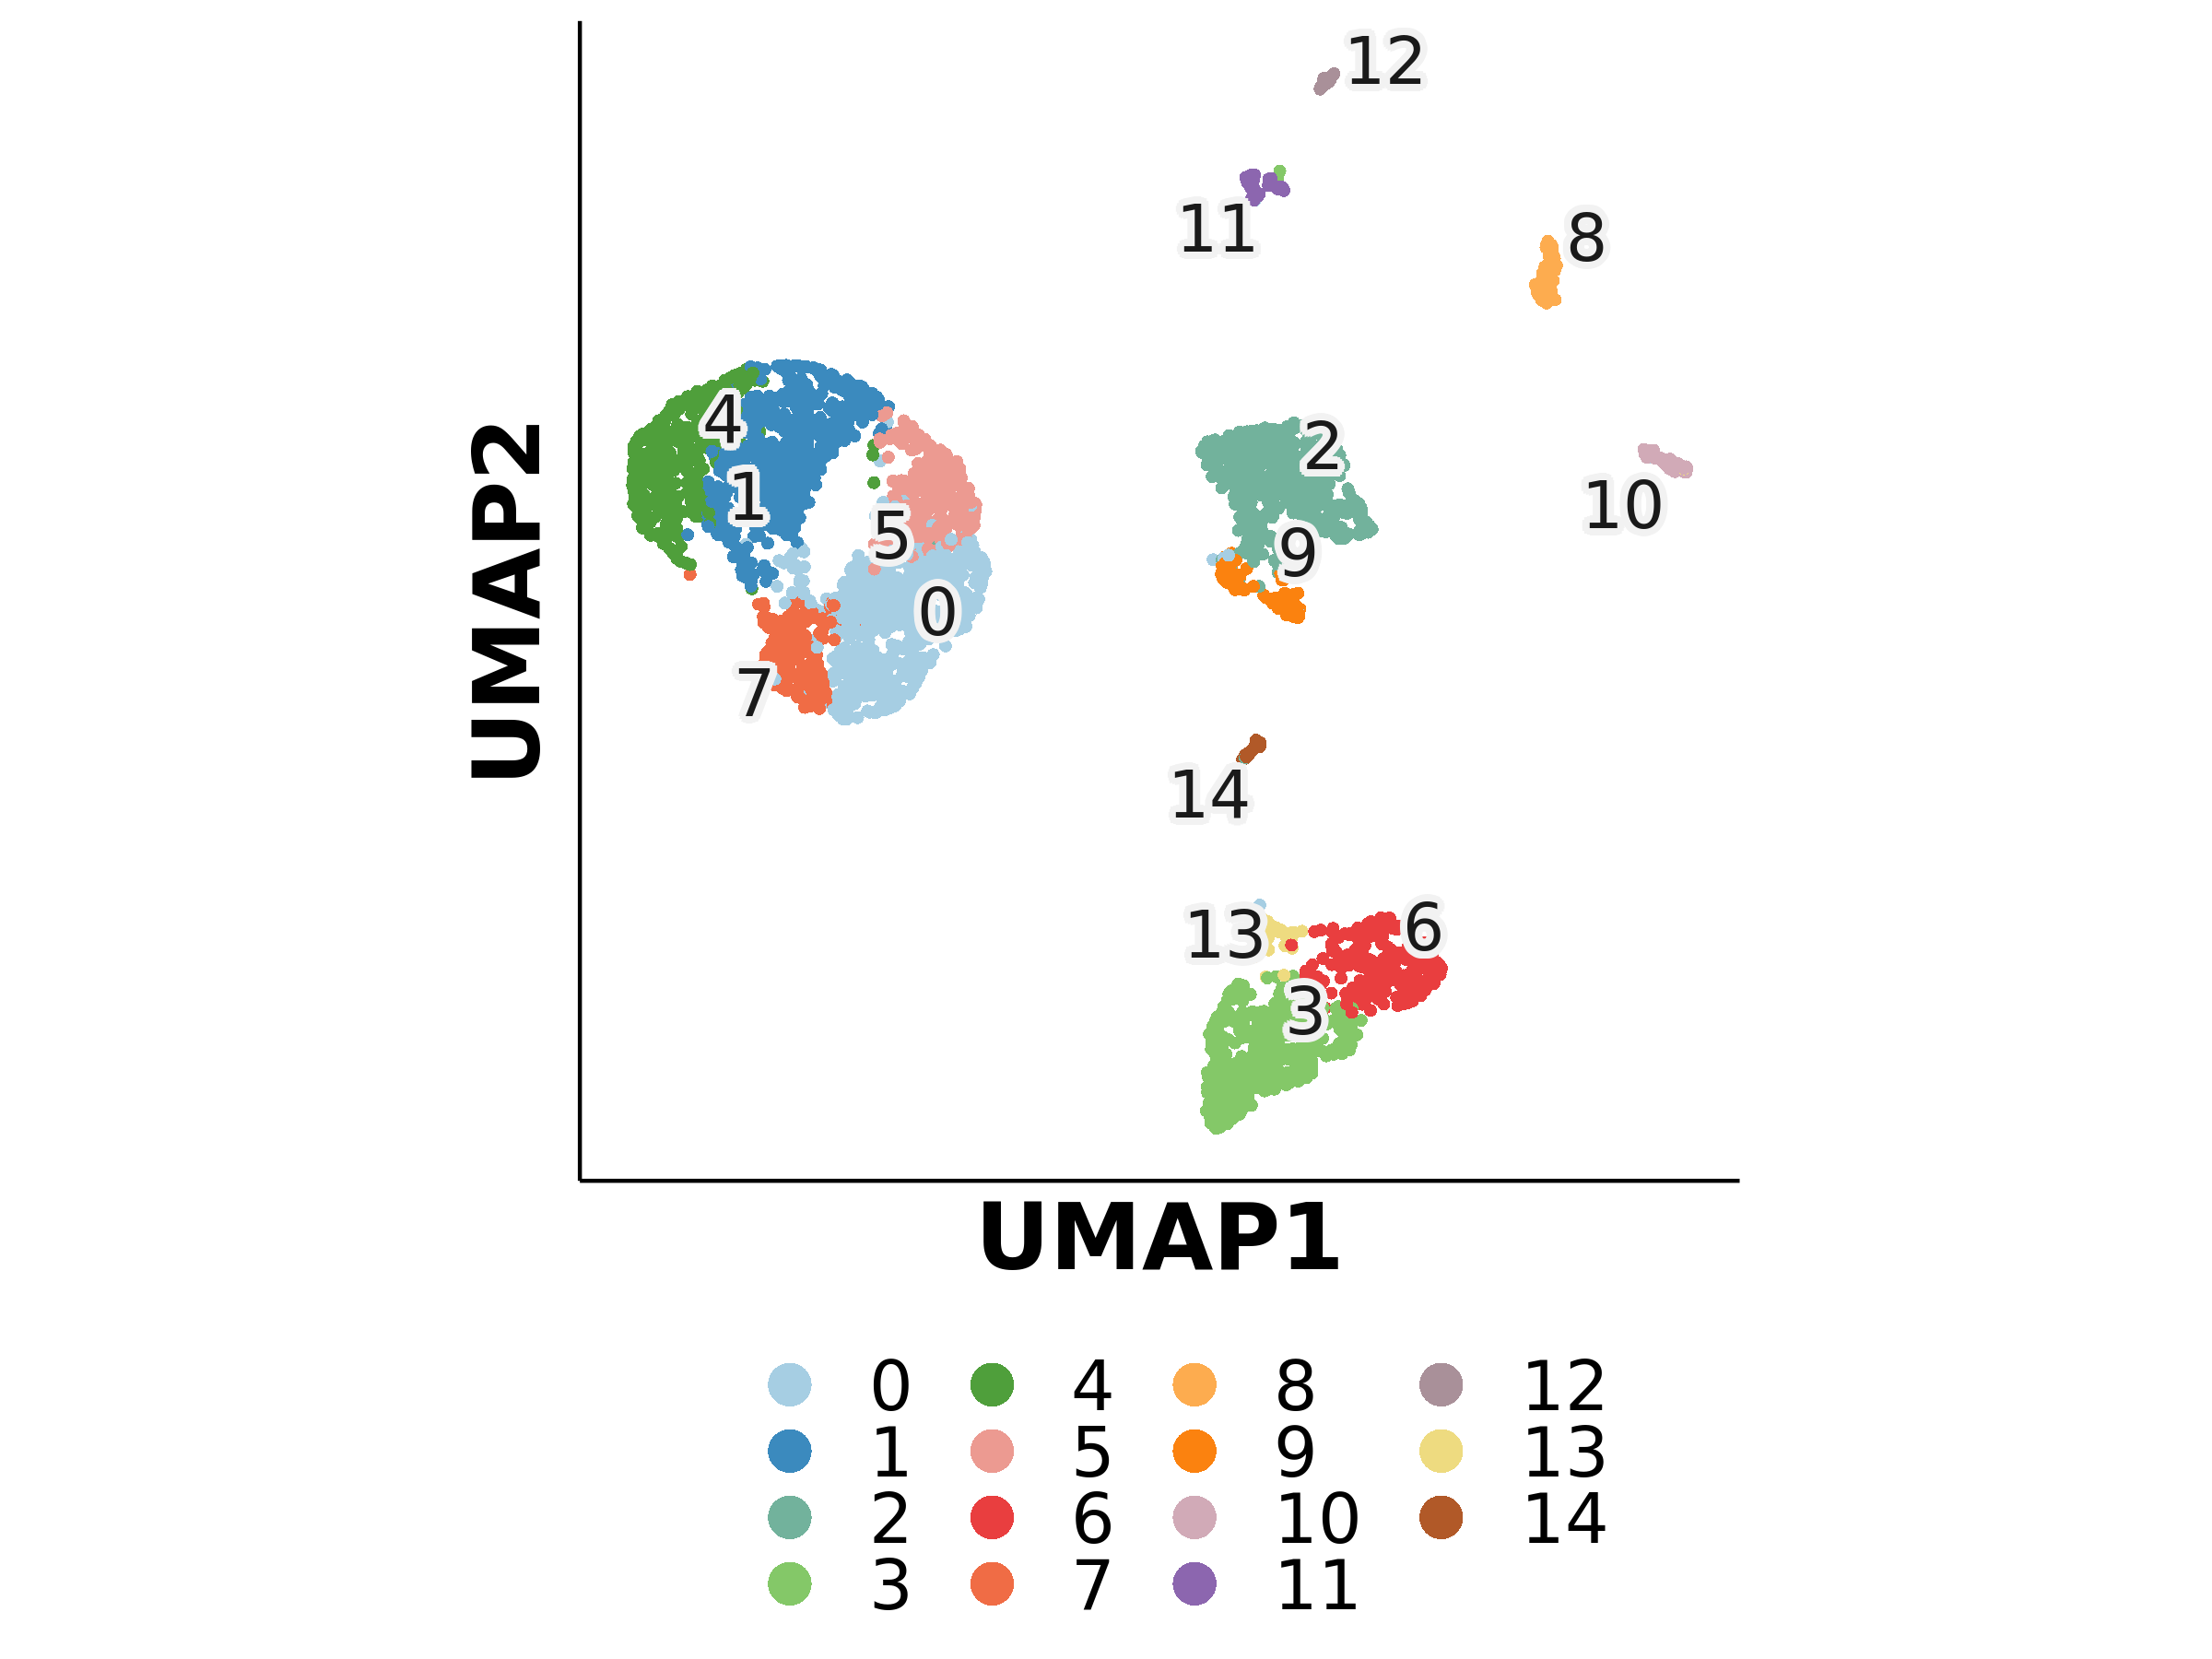
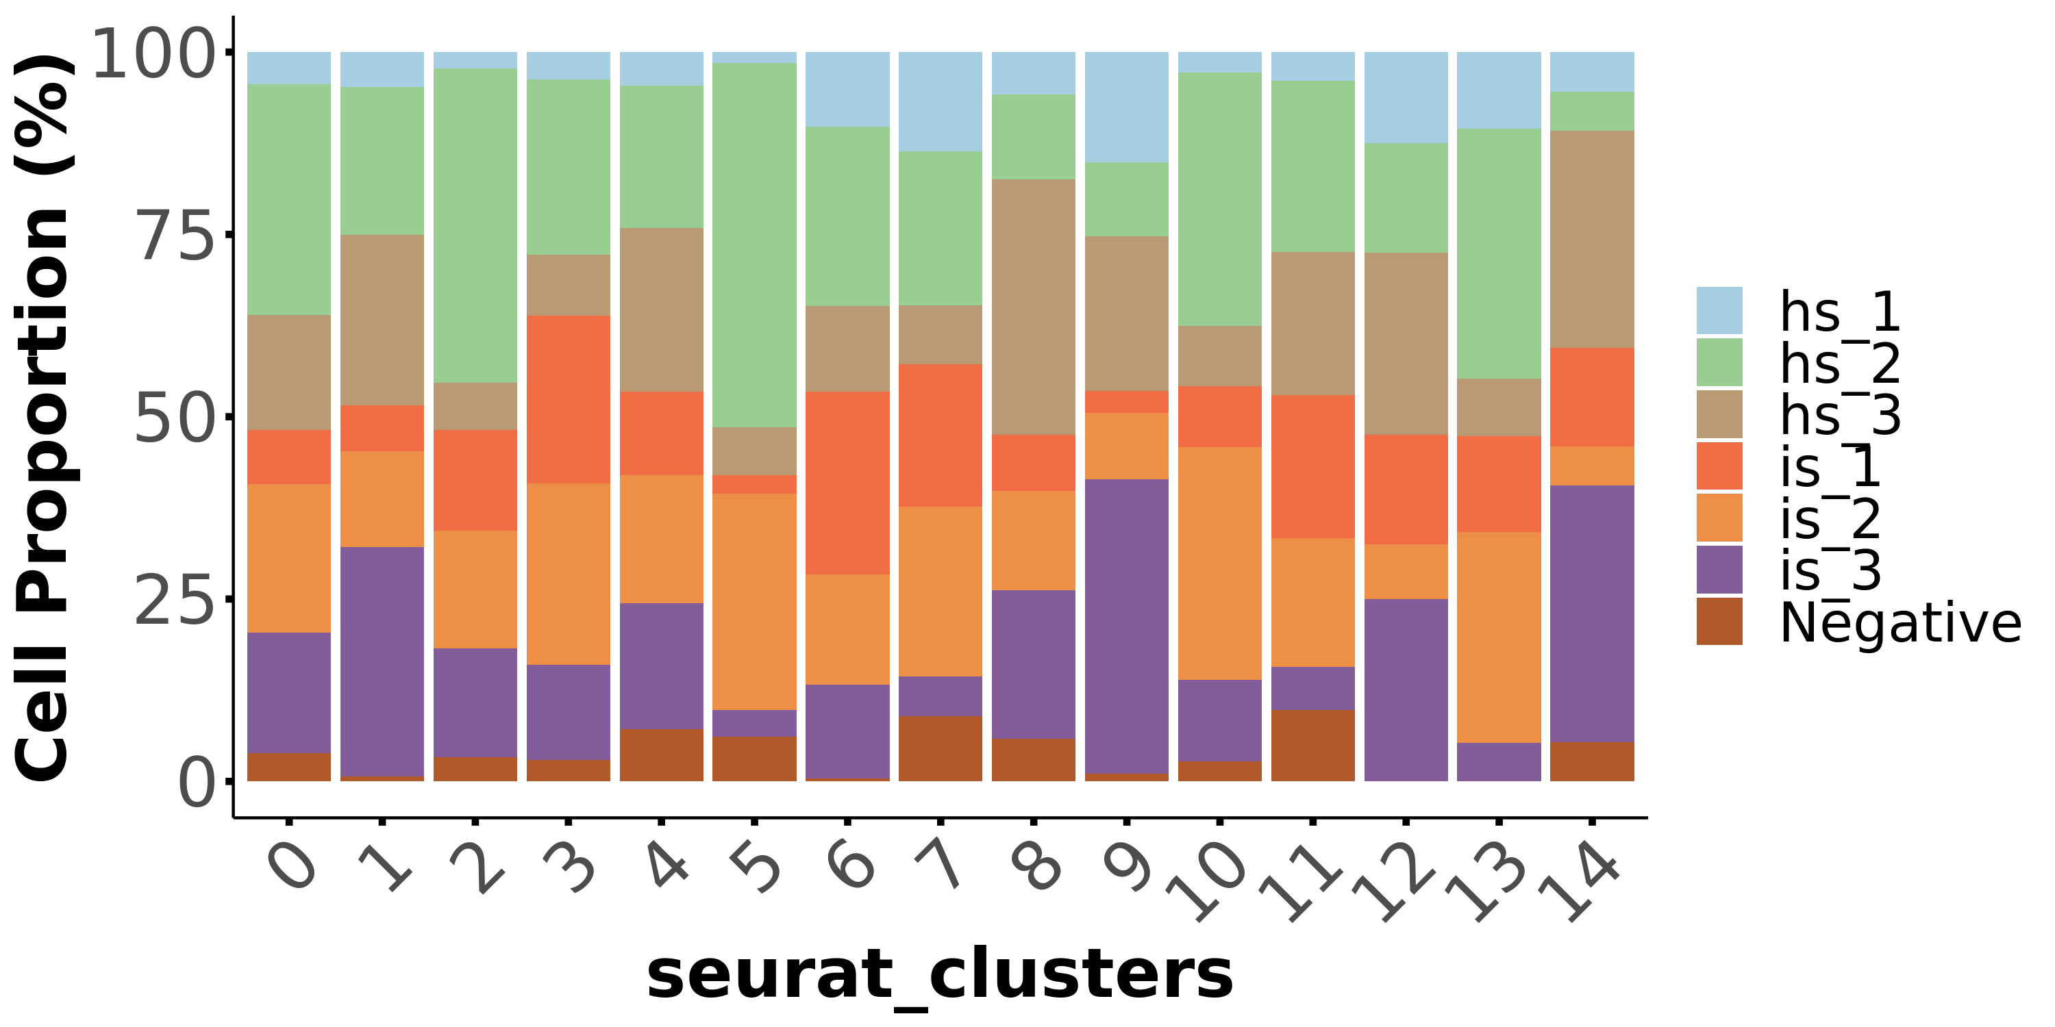
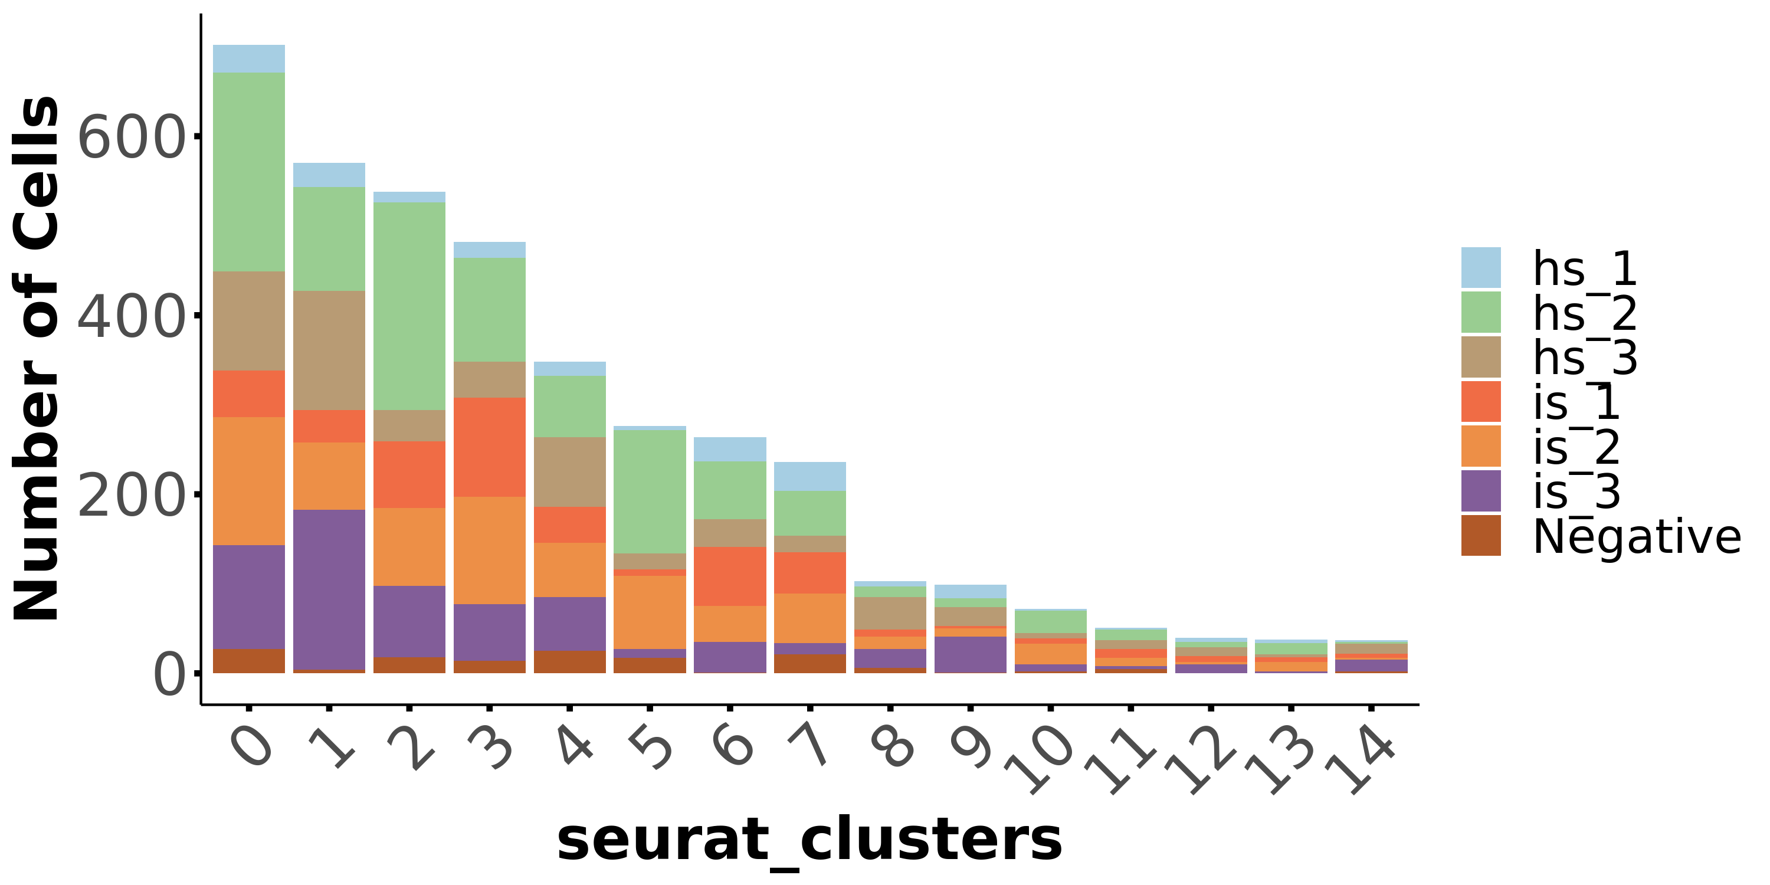
Human skin: Single cell sequencing Data – Mesenchymal cells

Slide 4
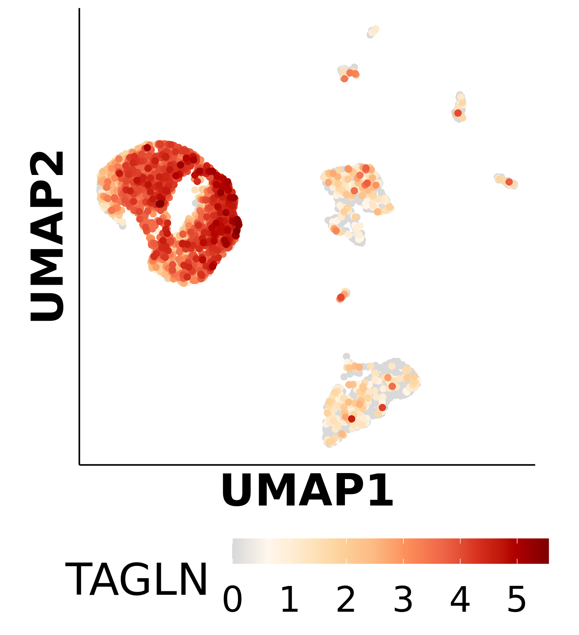
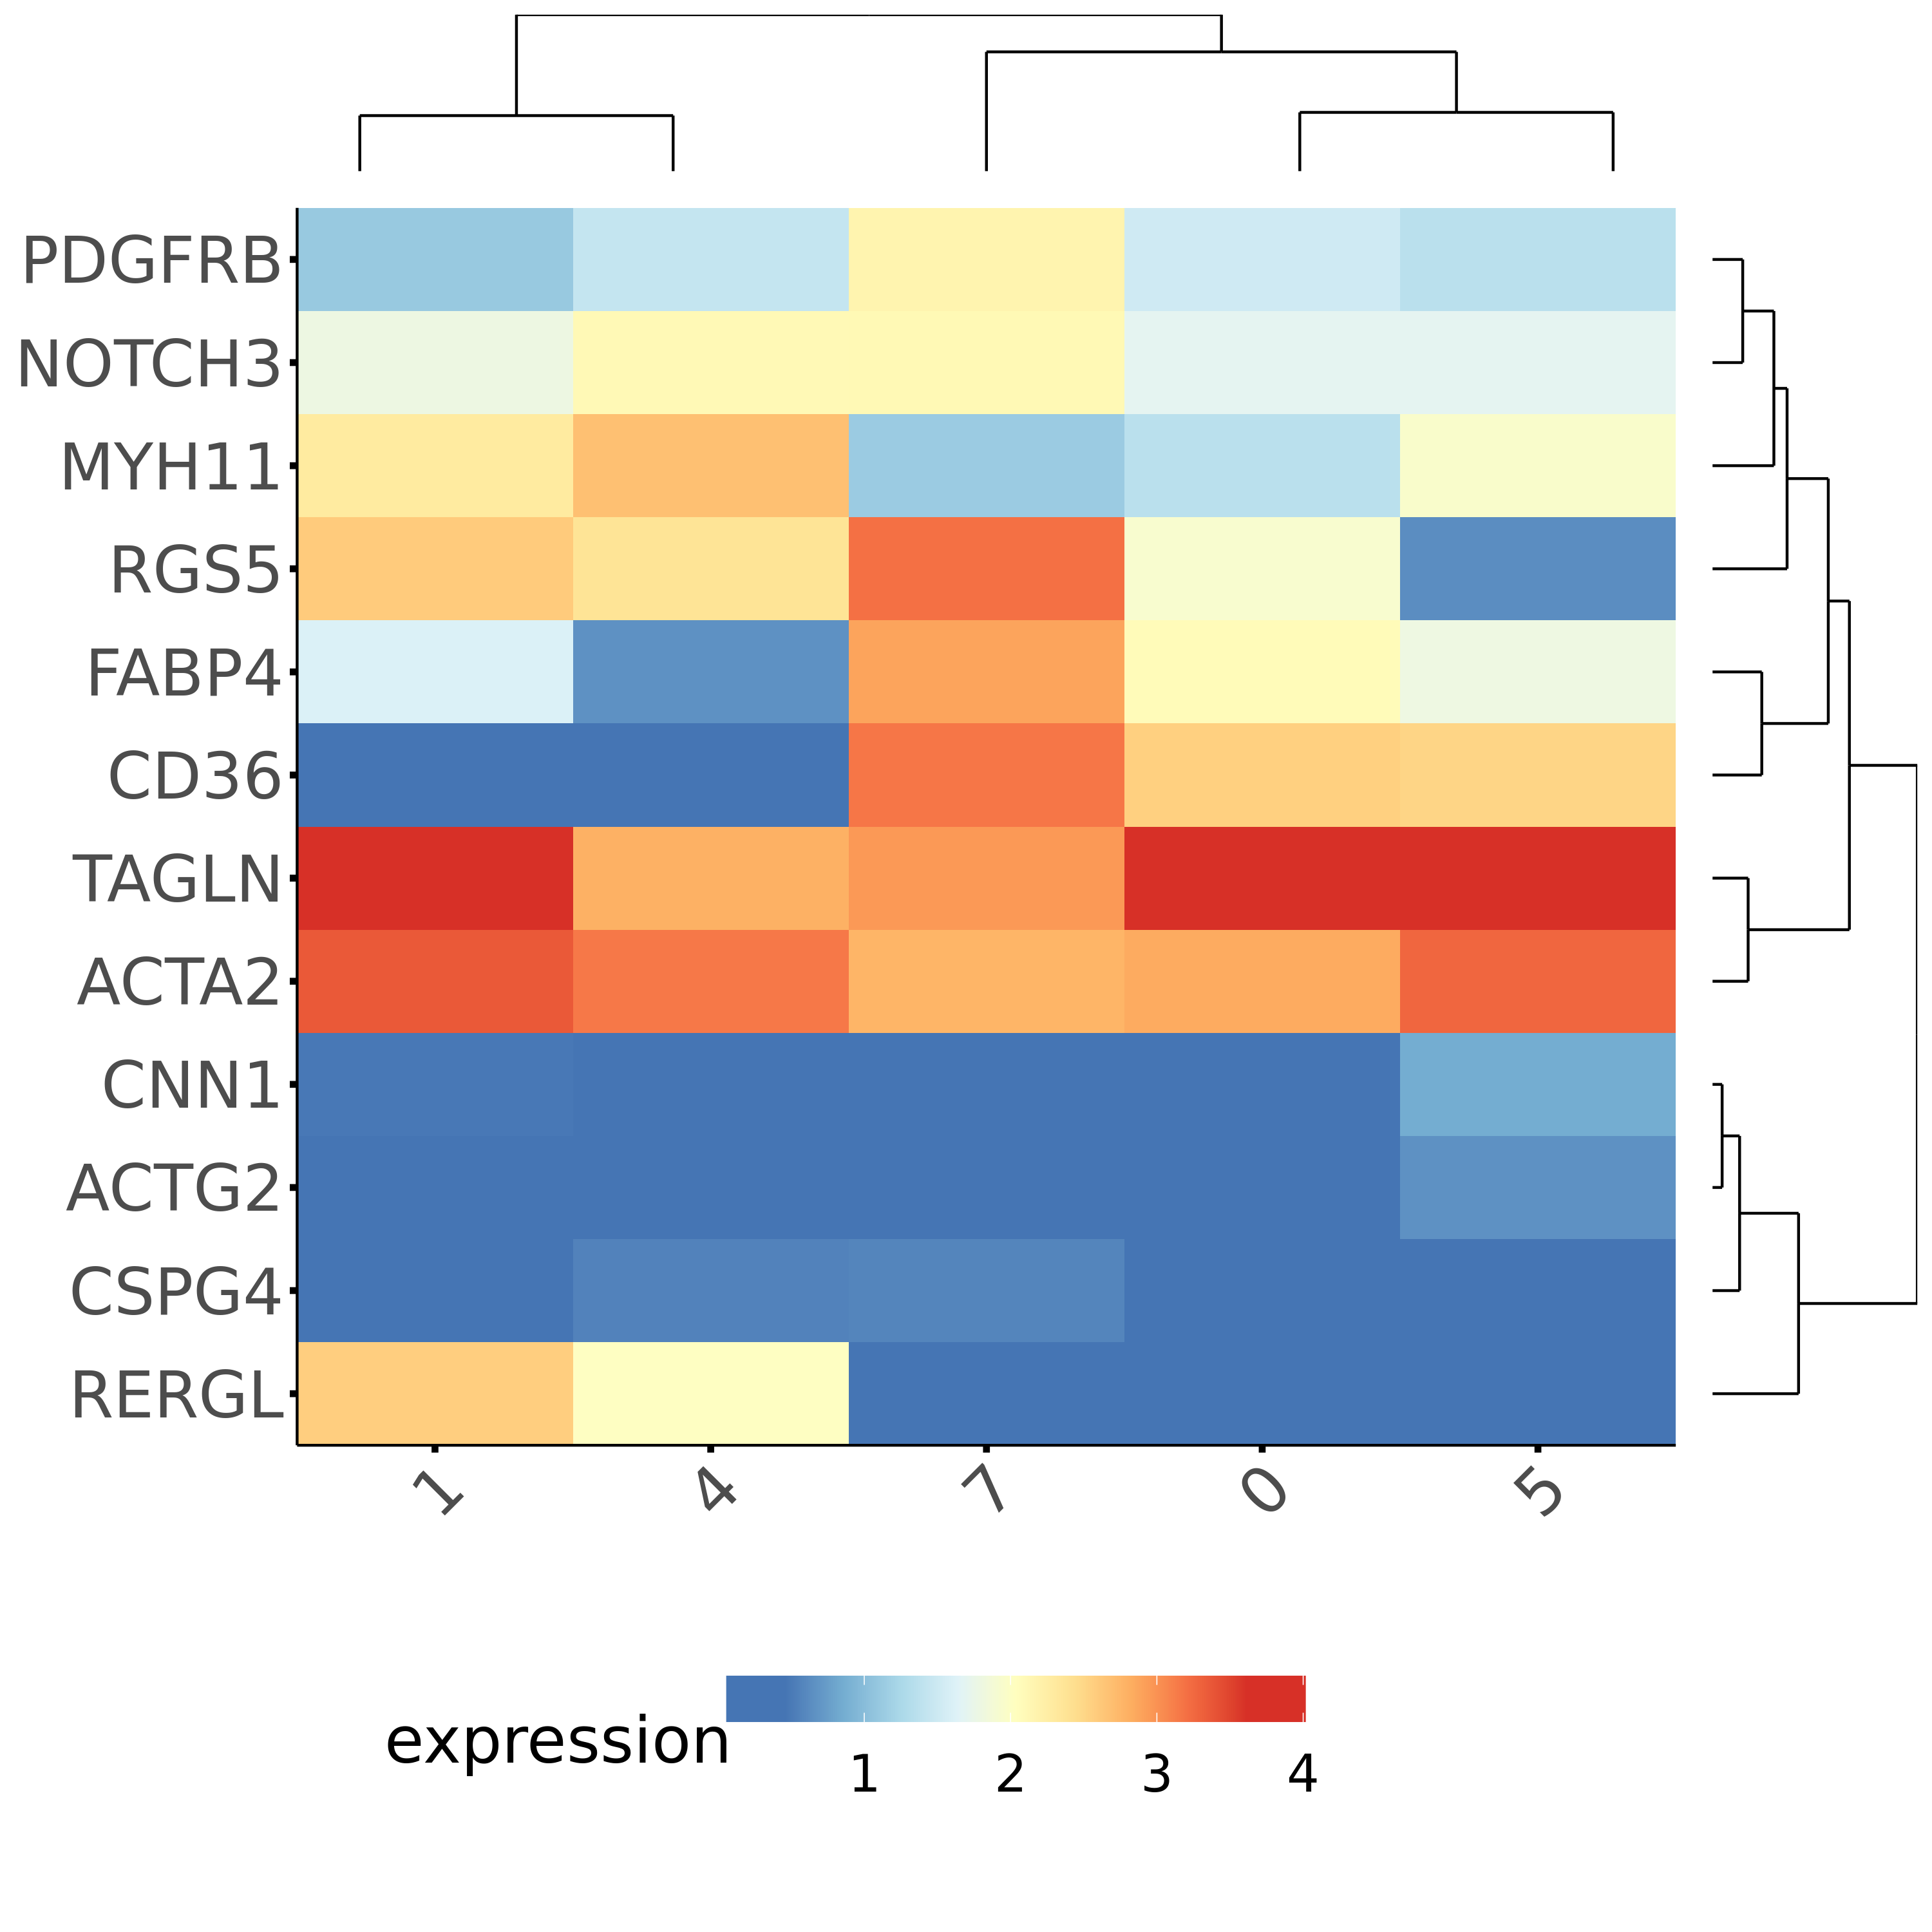
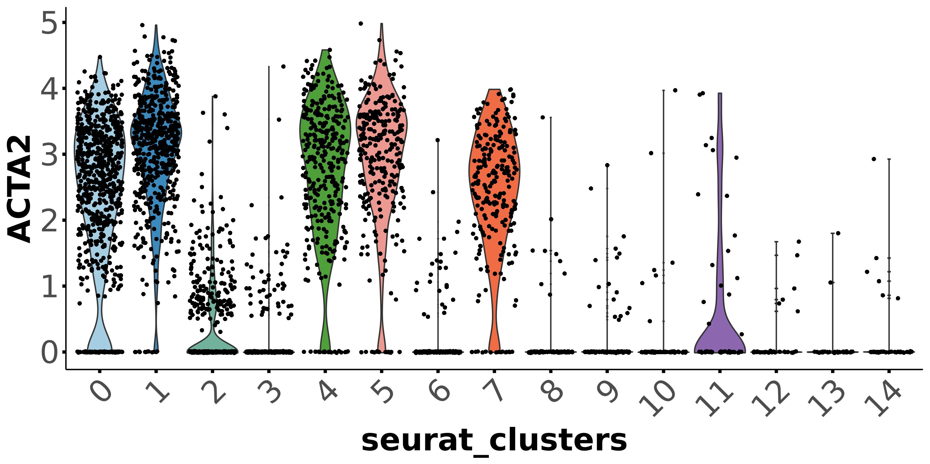
Pericytes + vSMC
vSMC
Pericytes

Slide 5
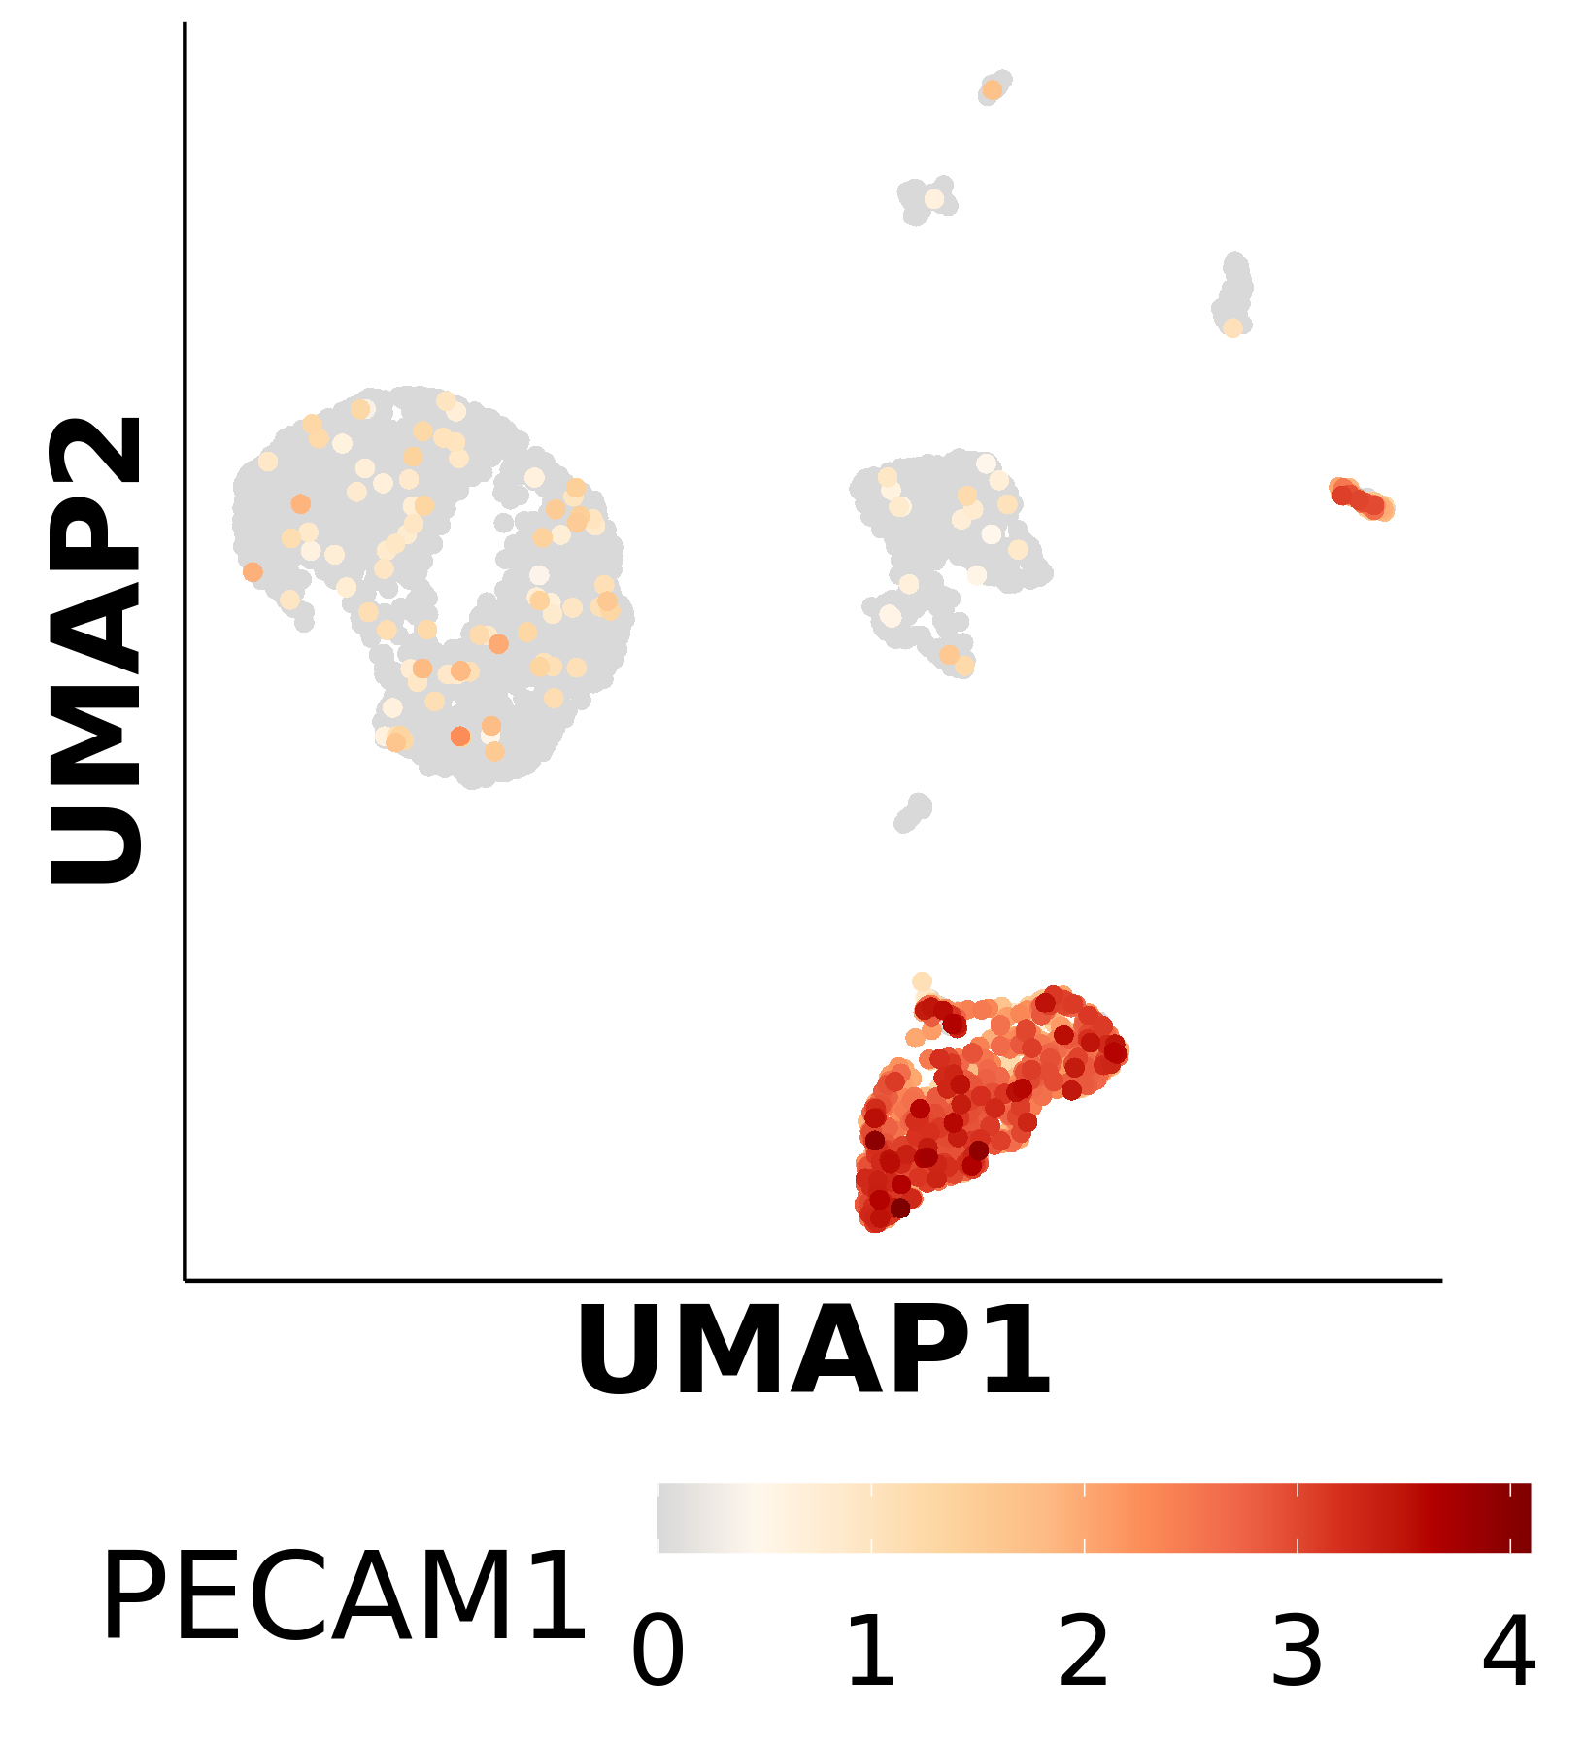
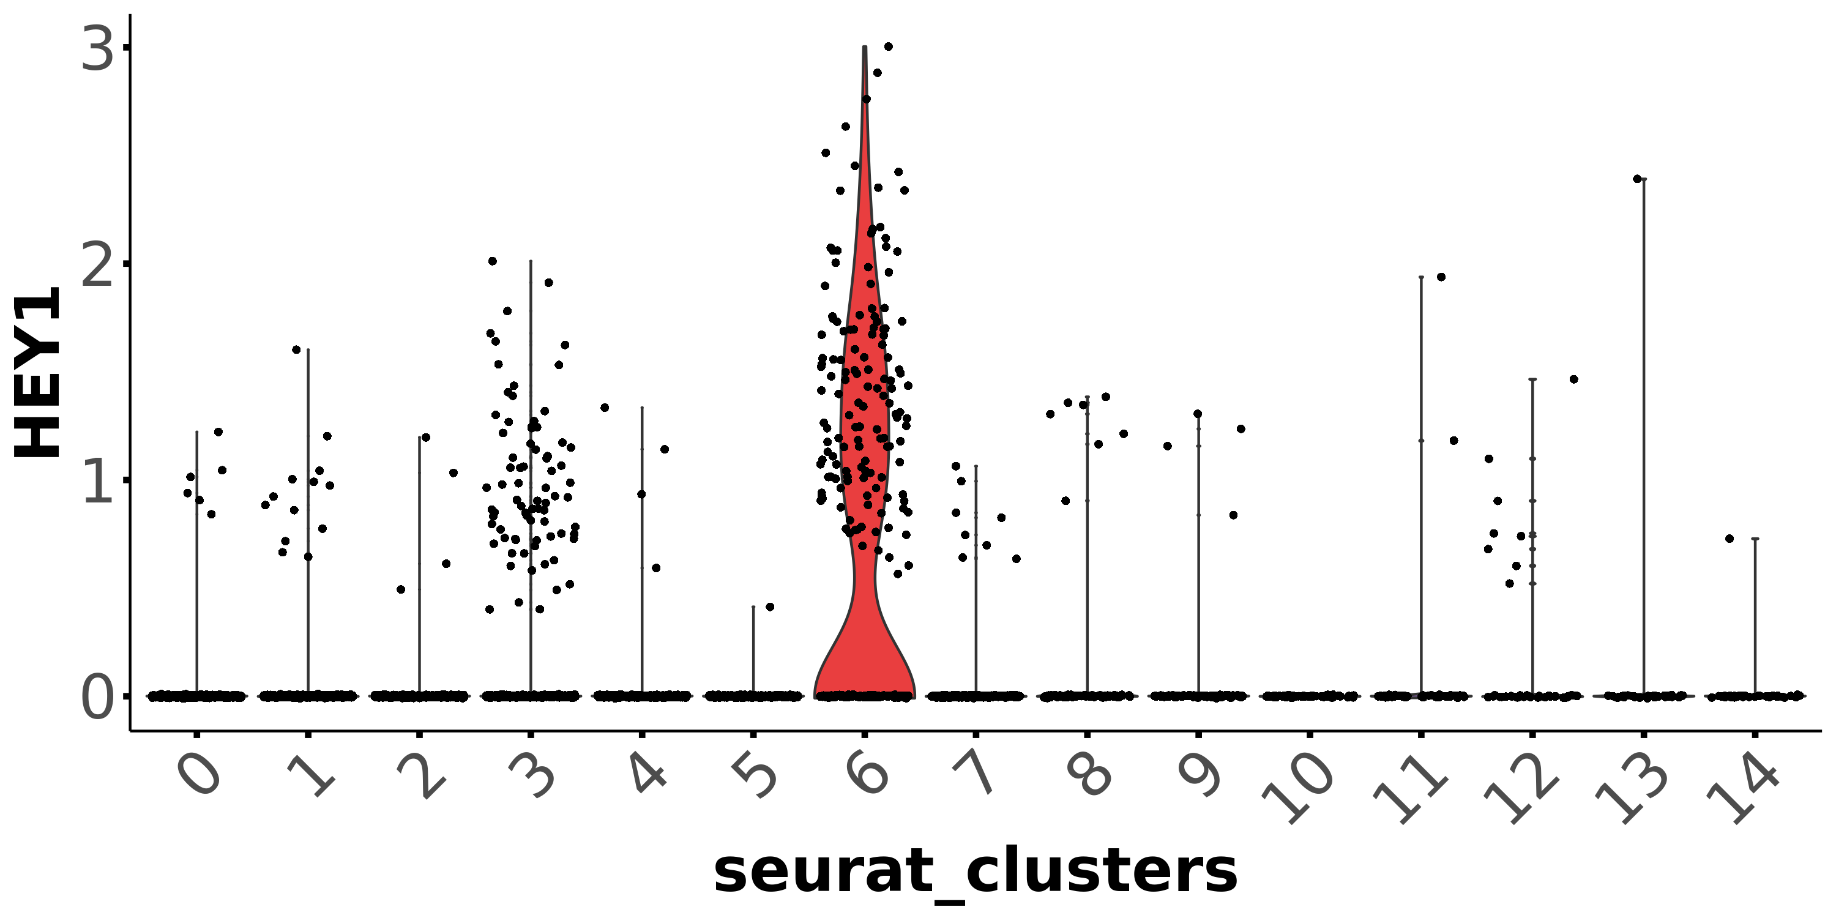
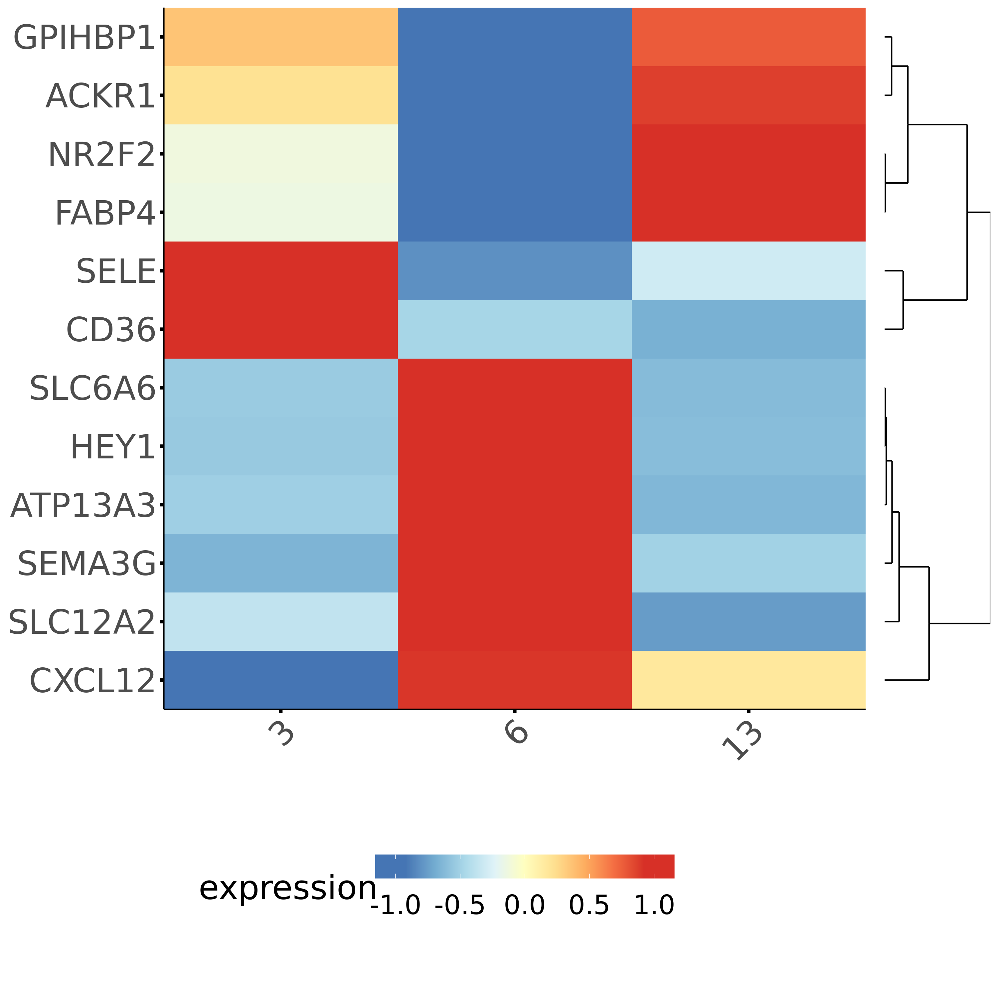
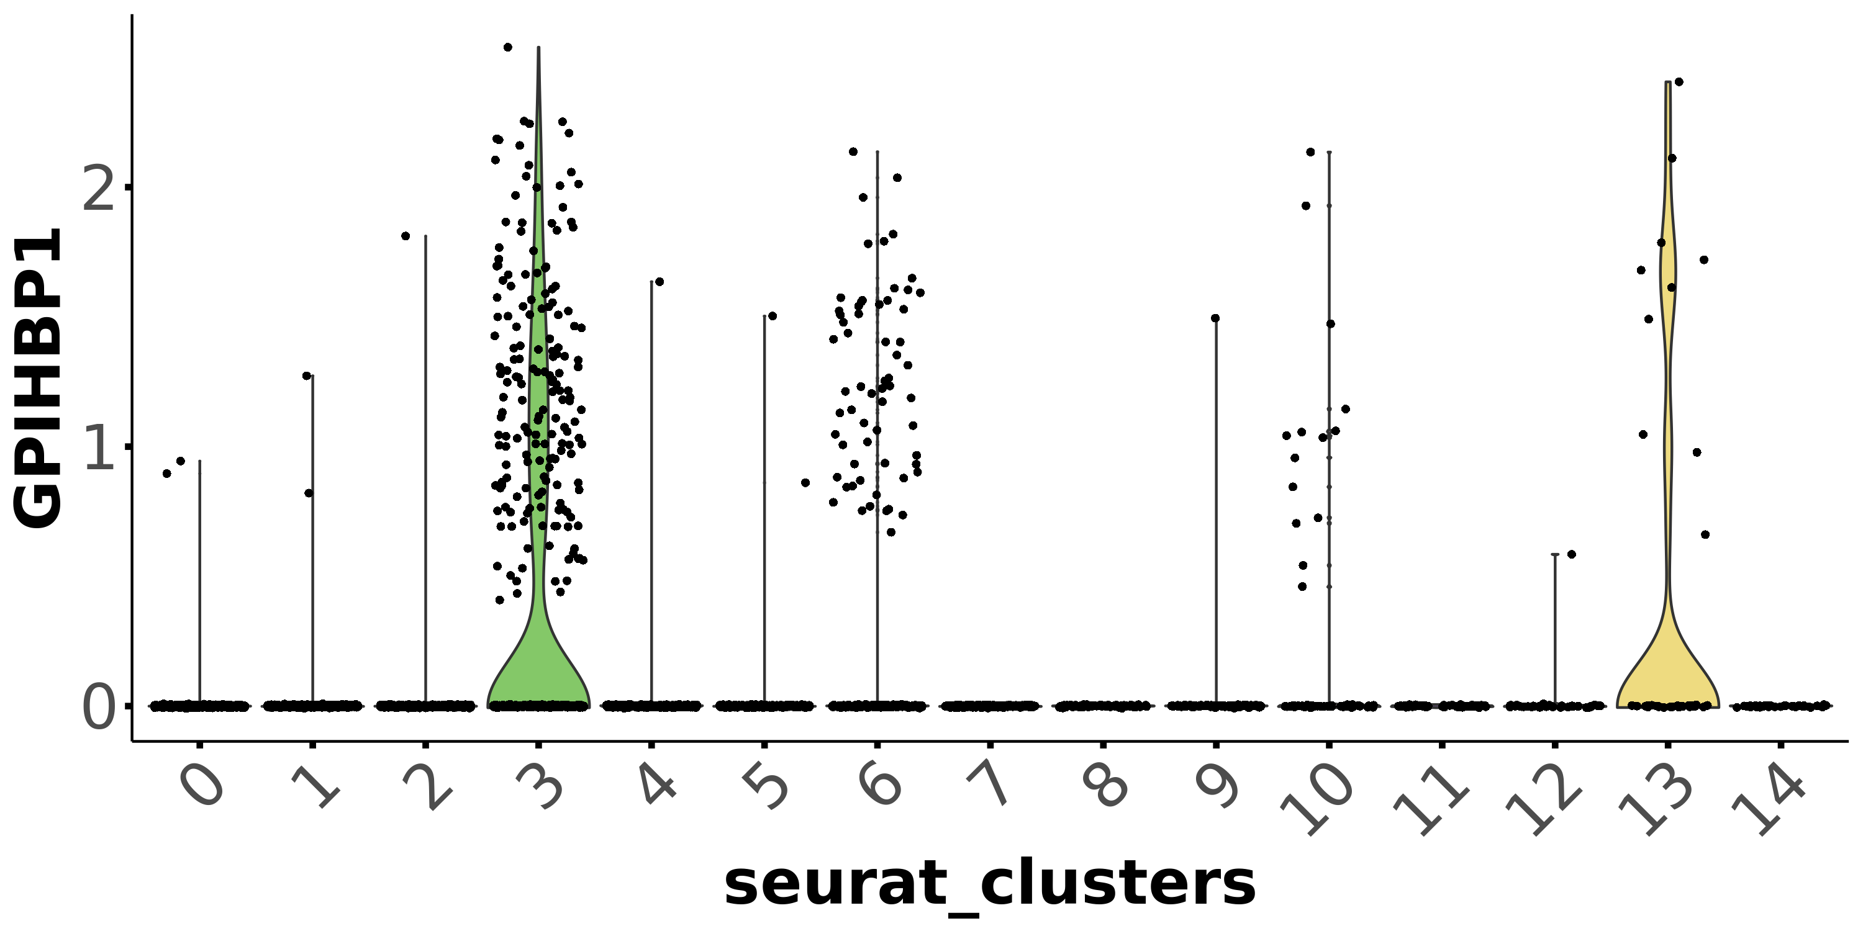
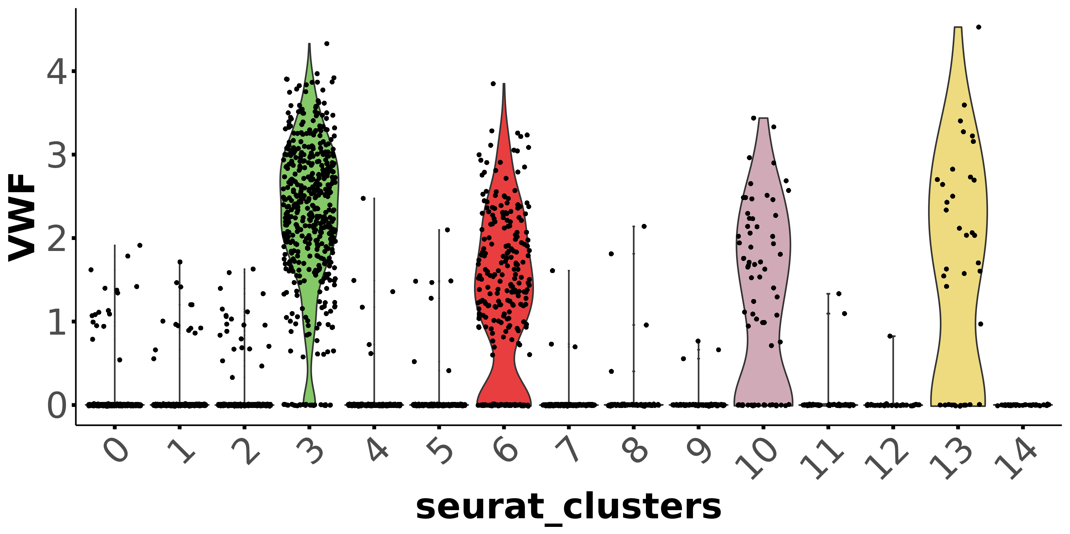
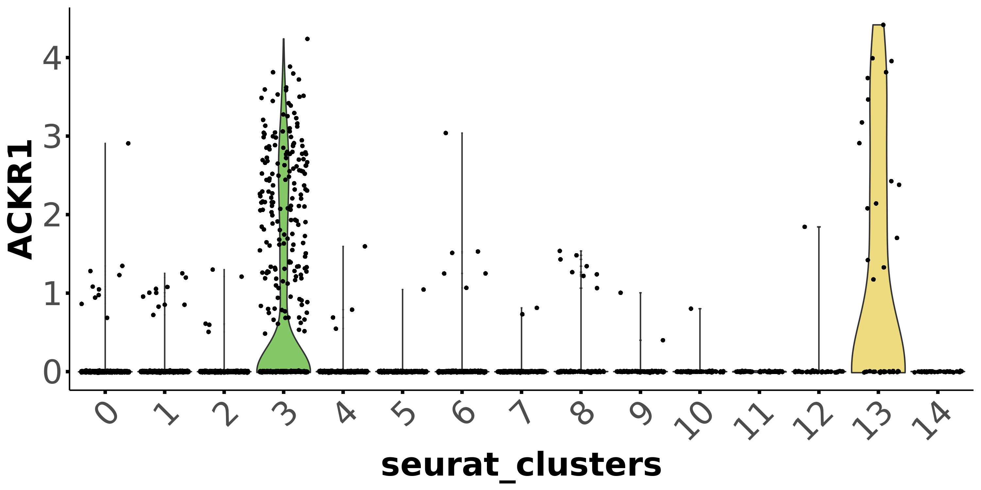
Endothelial cells
Vascular EC - arterial
capillary
arterial
venular
Vascular EC - capillary
Vascular EC - venular

Slide 6
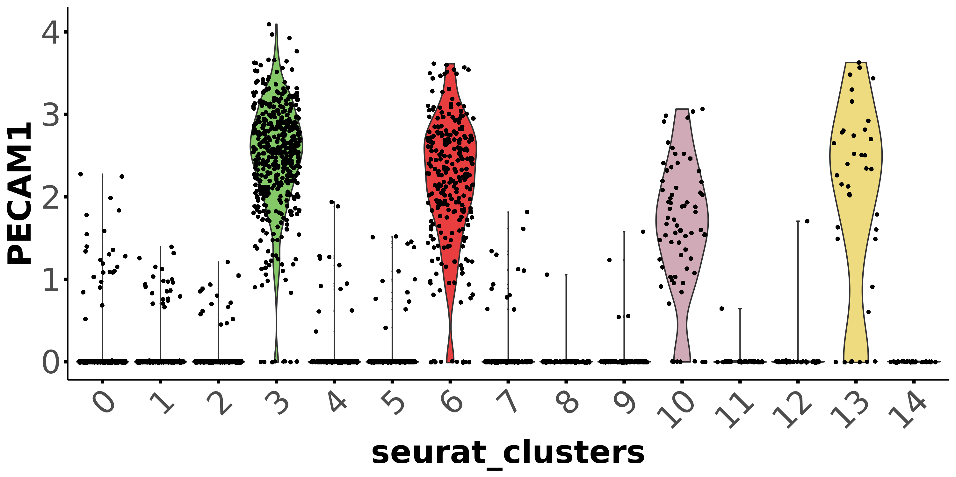
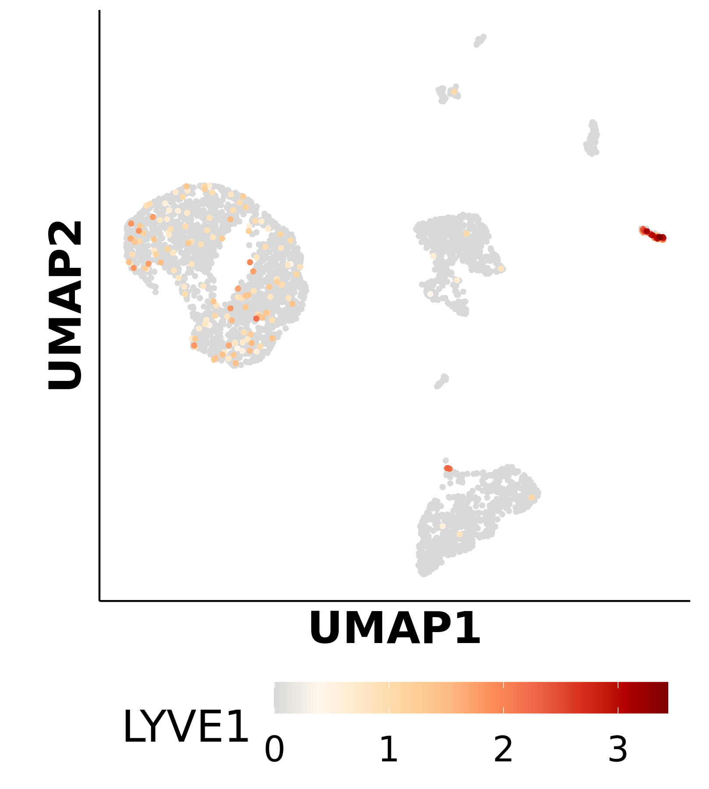
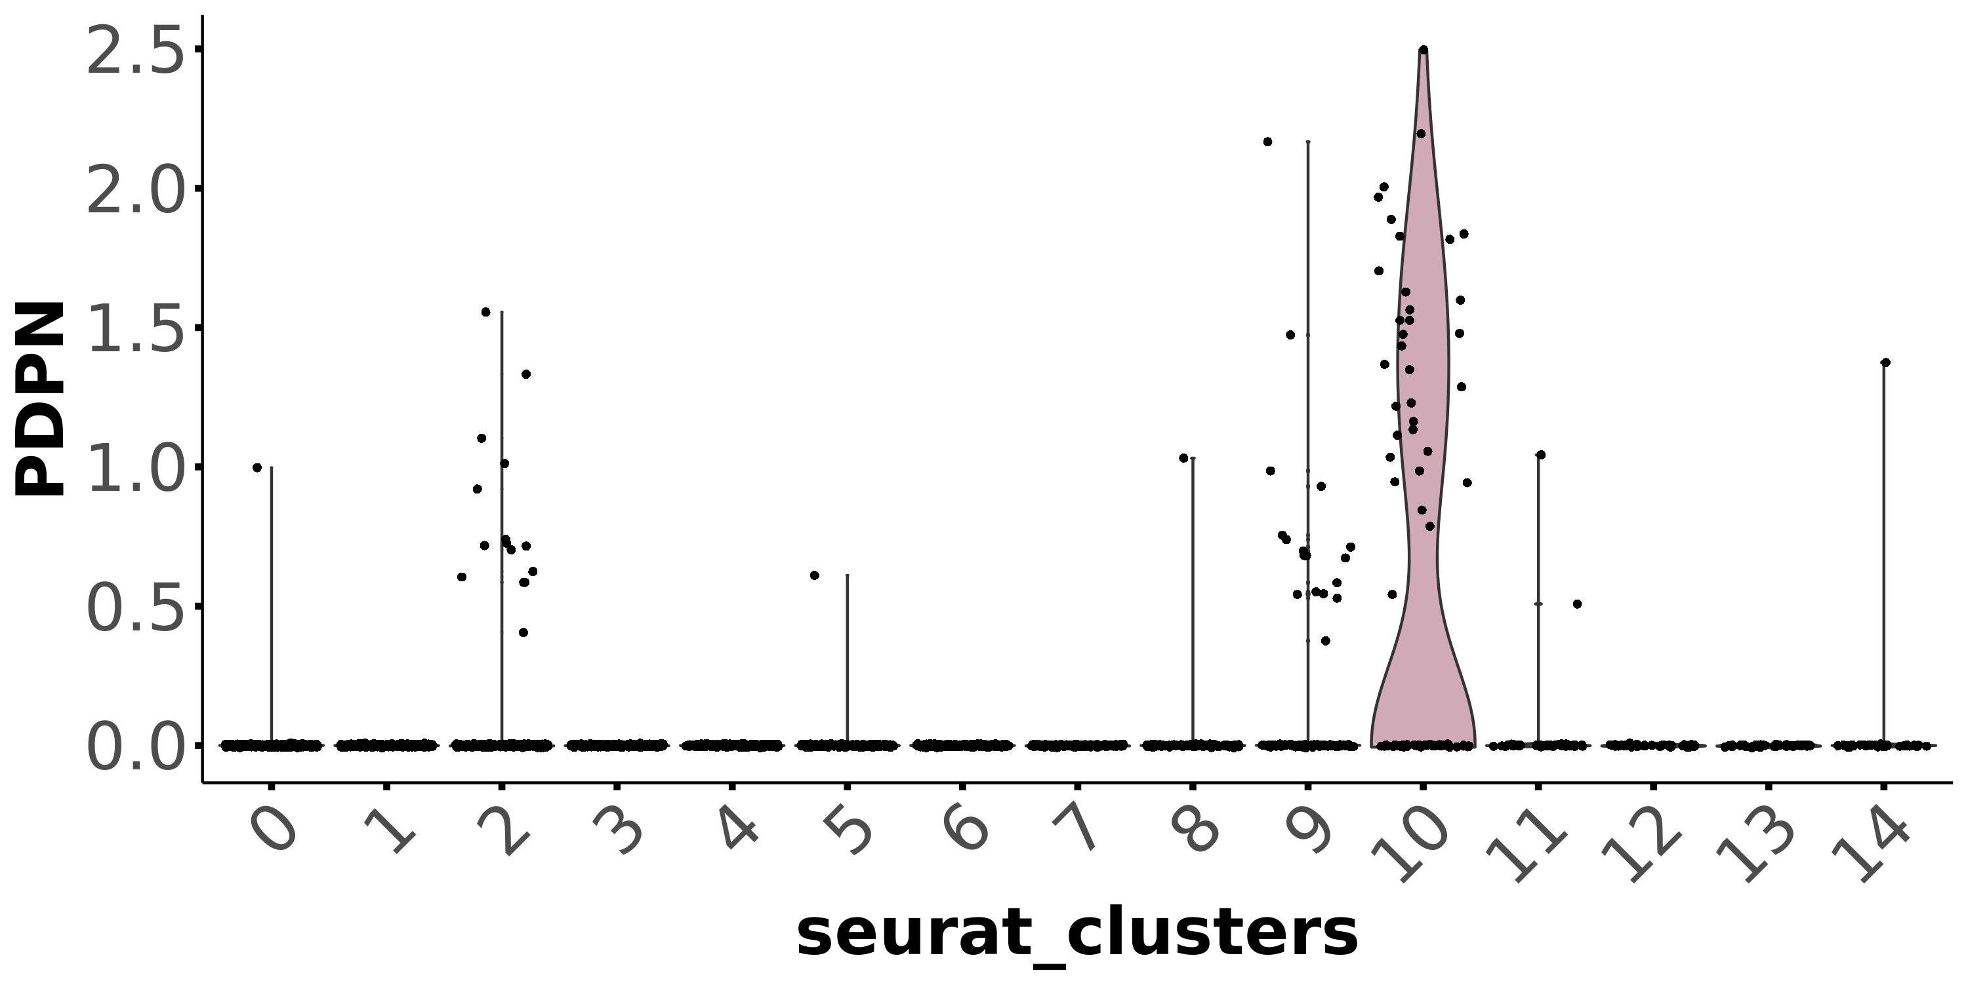
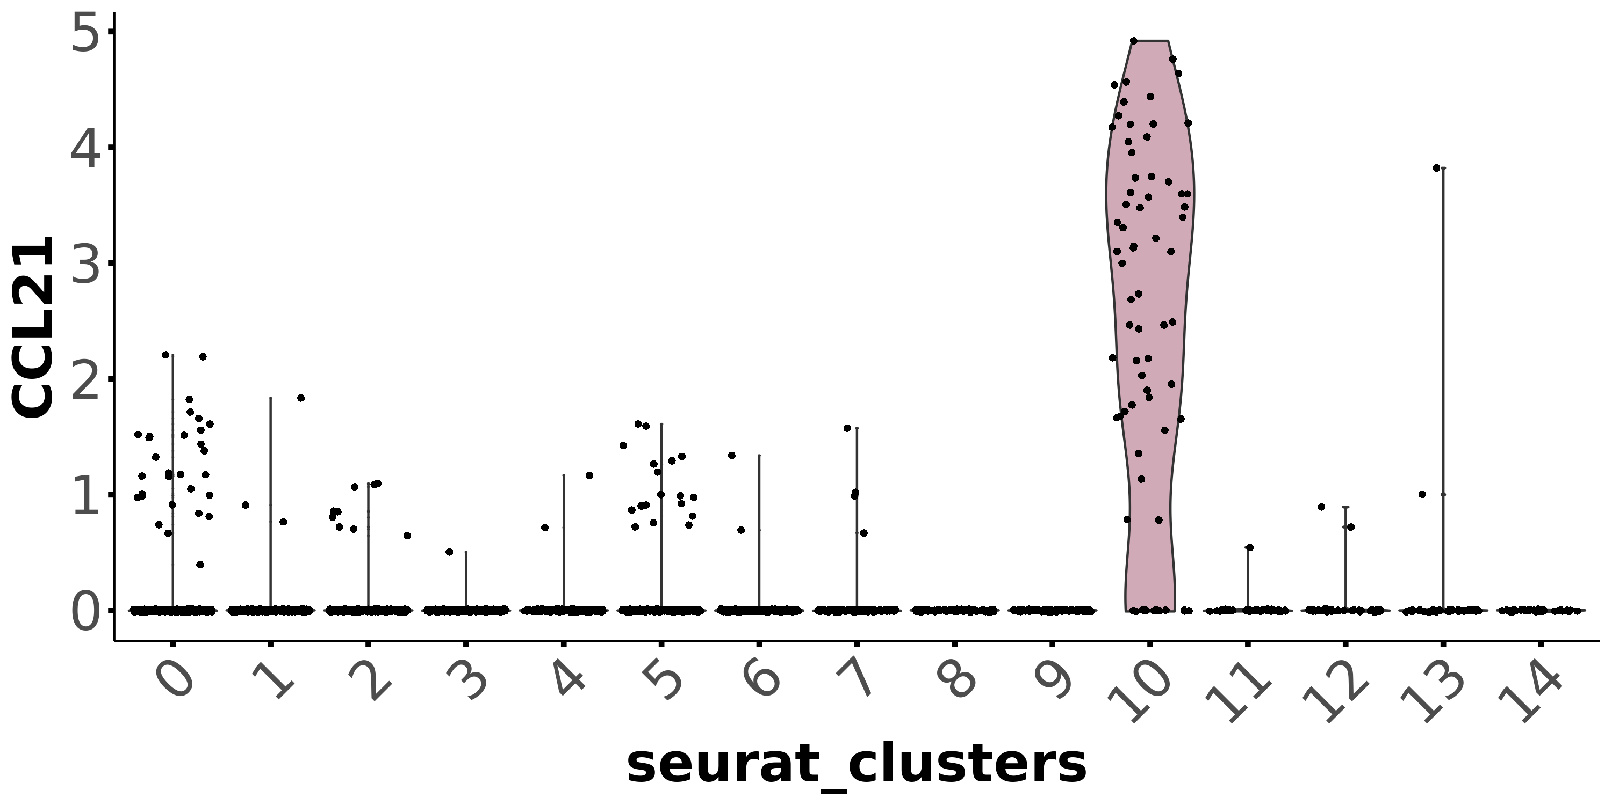
Endothelial cells
Lymphatic EC
Cluster# 10

Slide 7
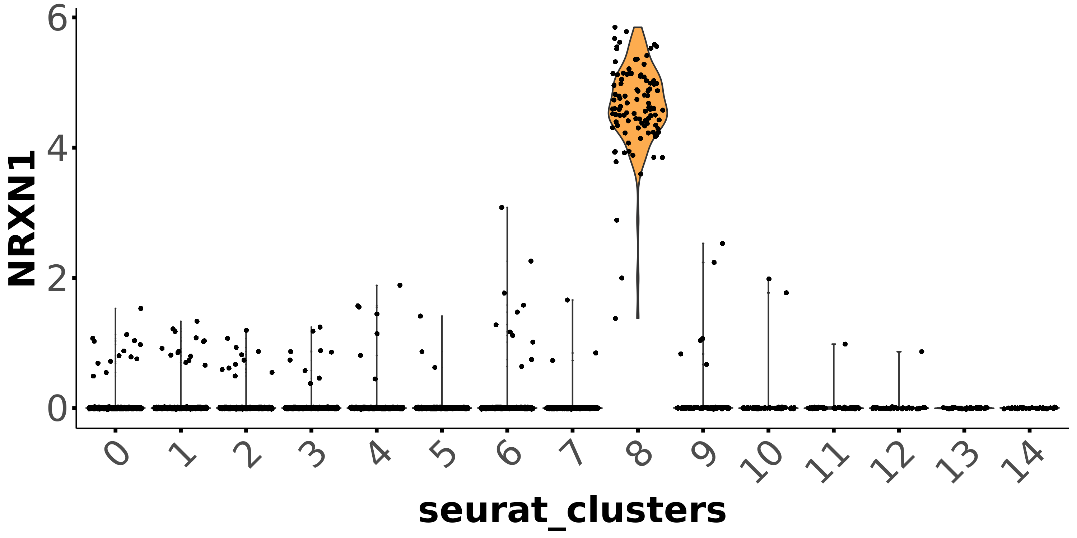
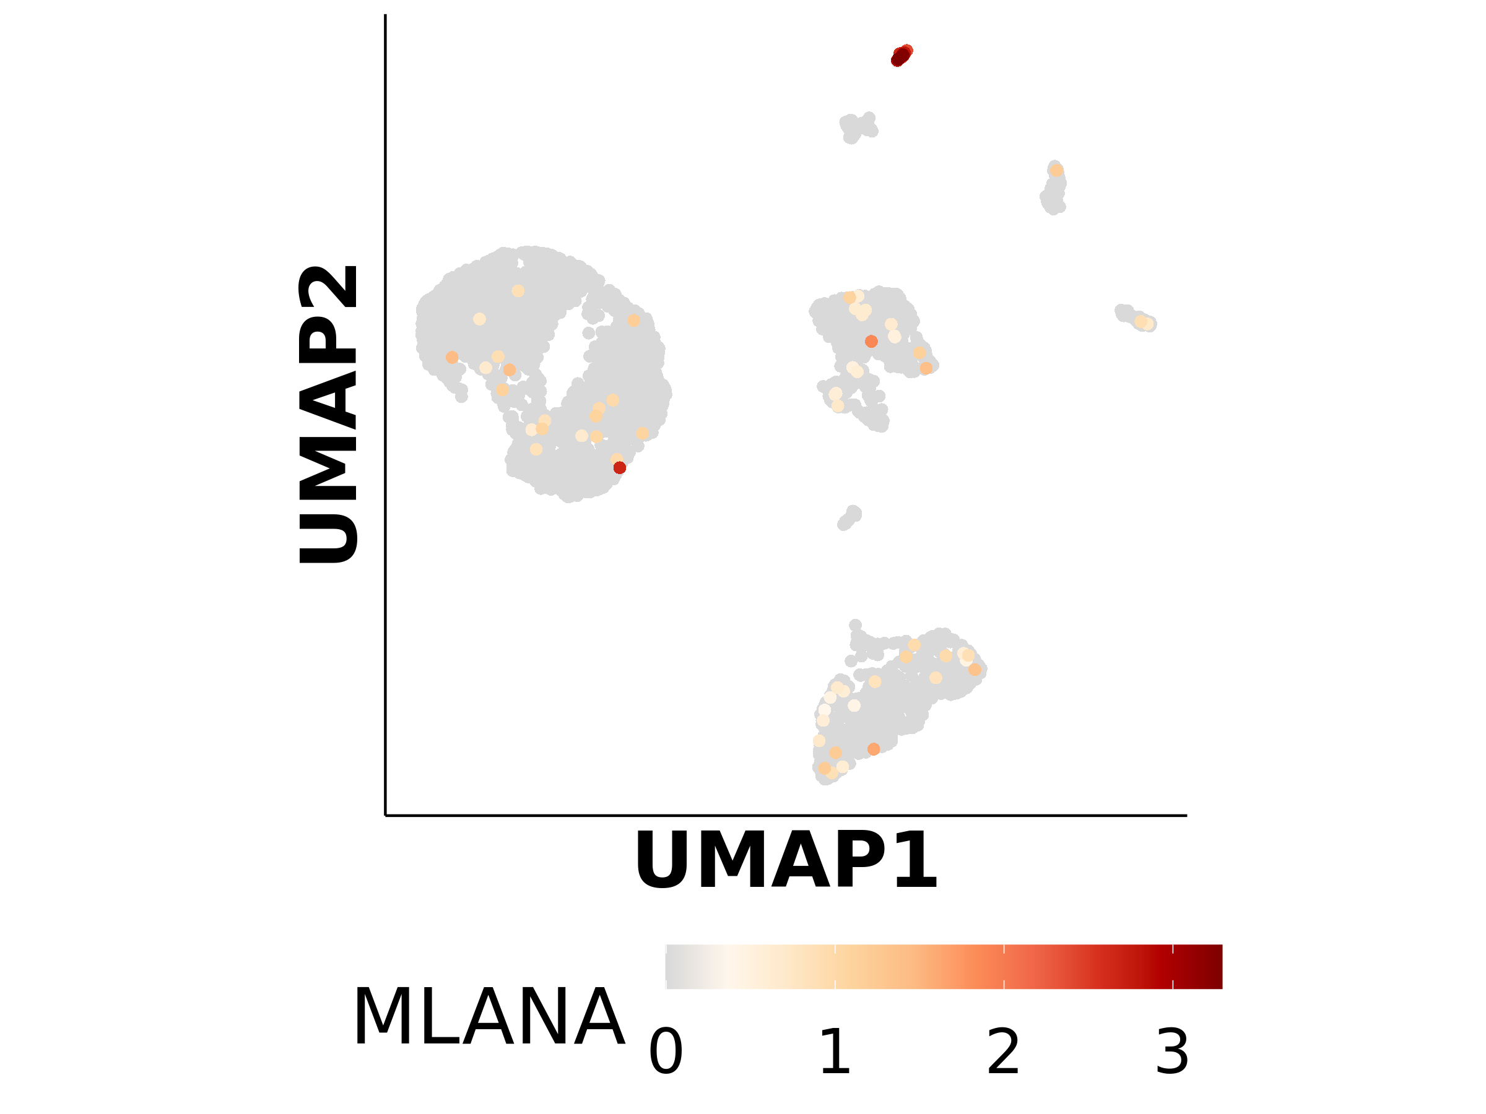
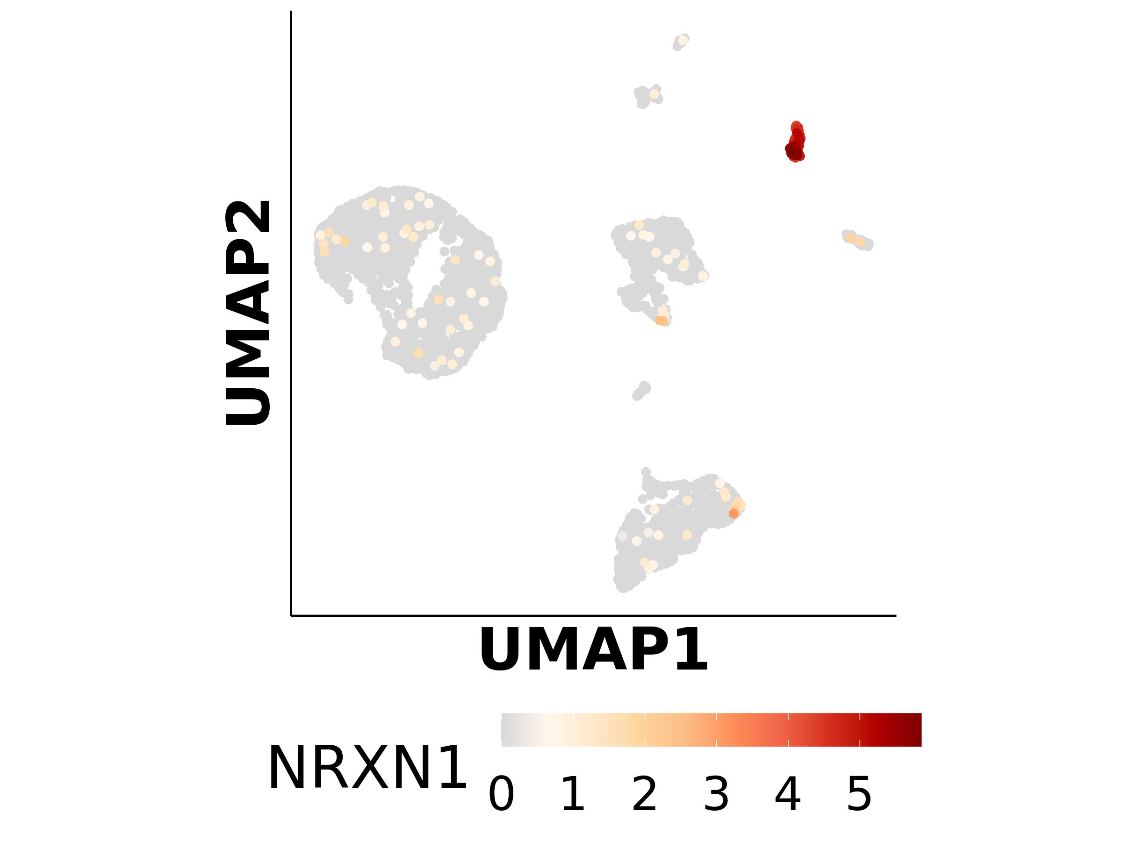
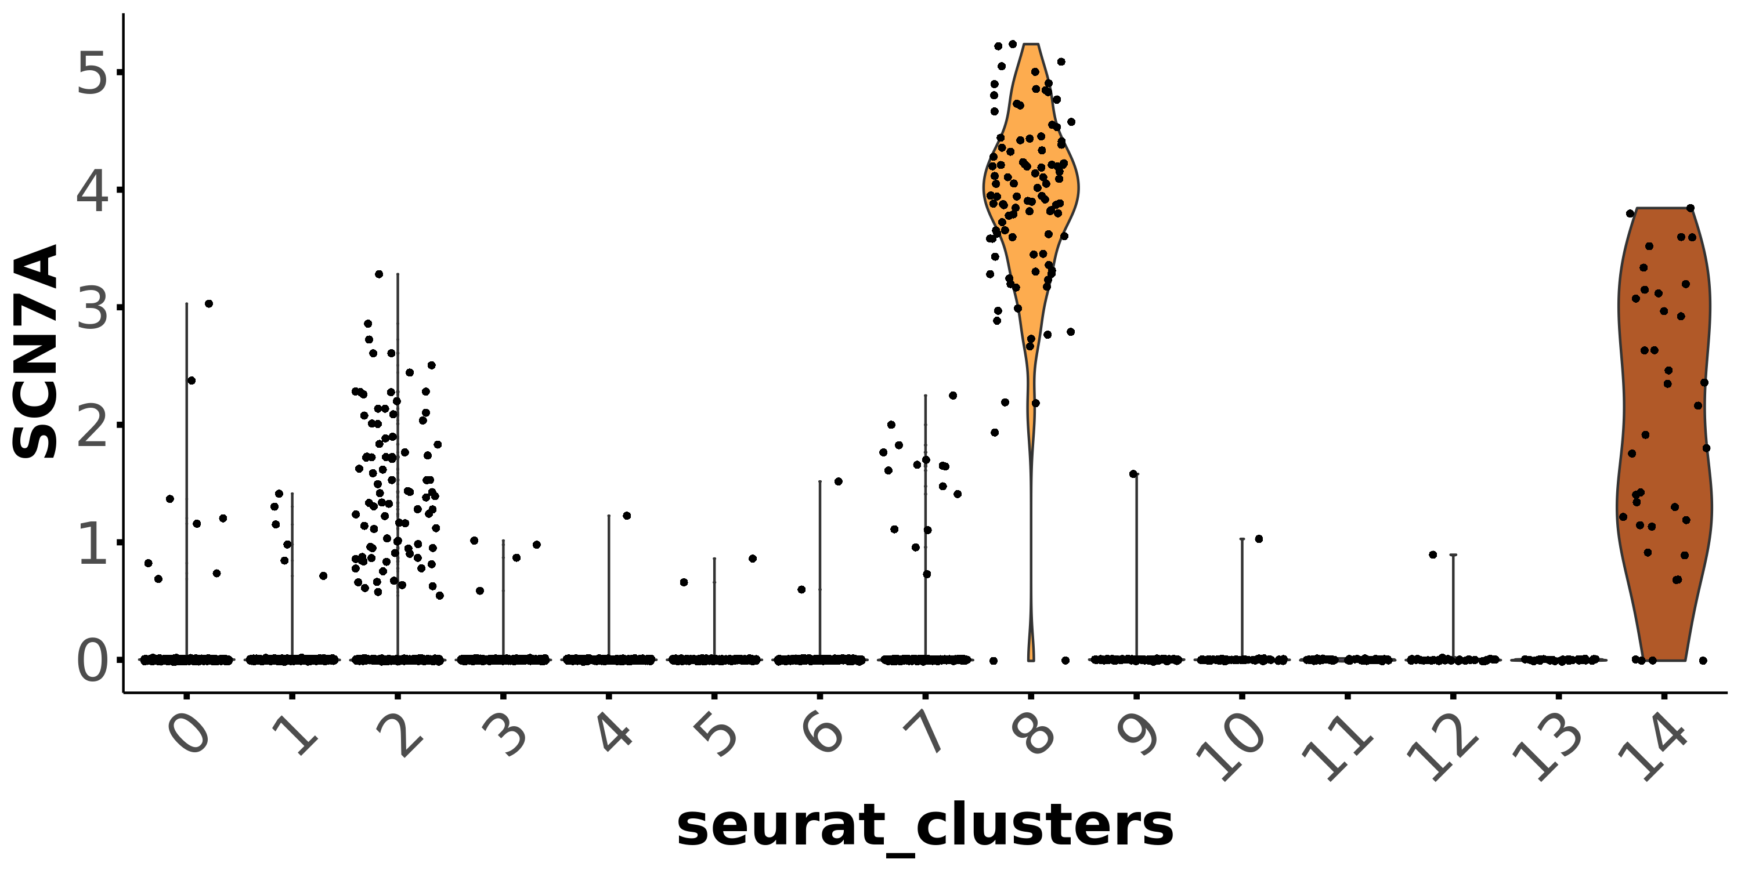
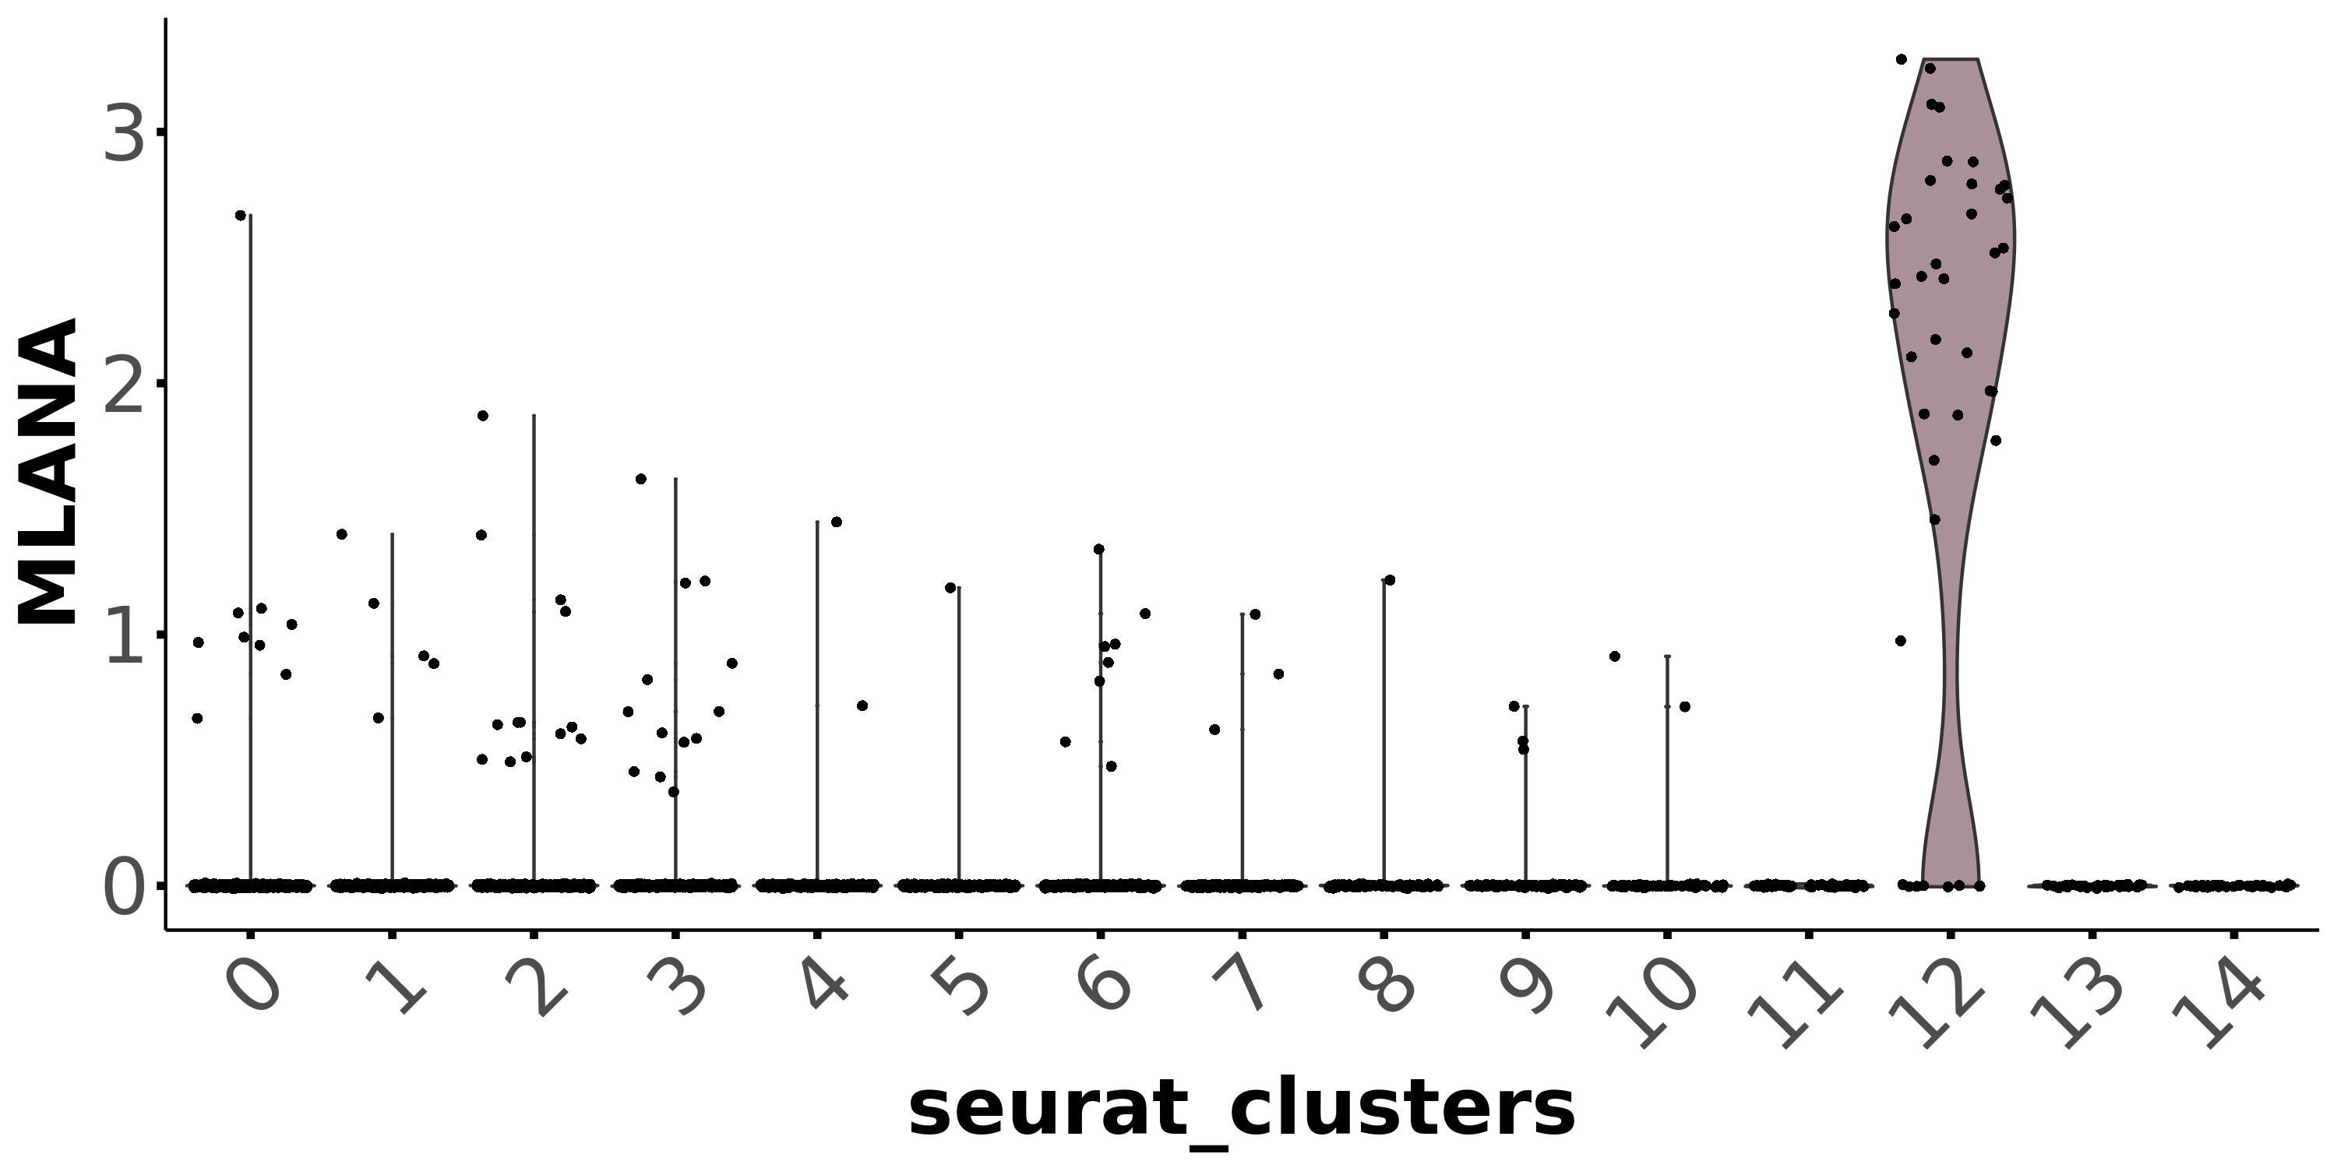
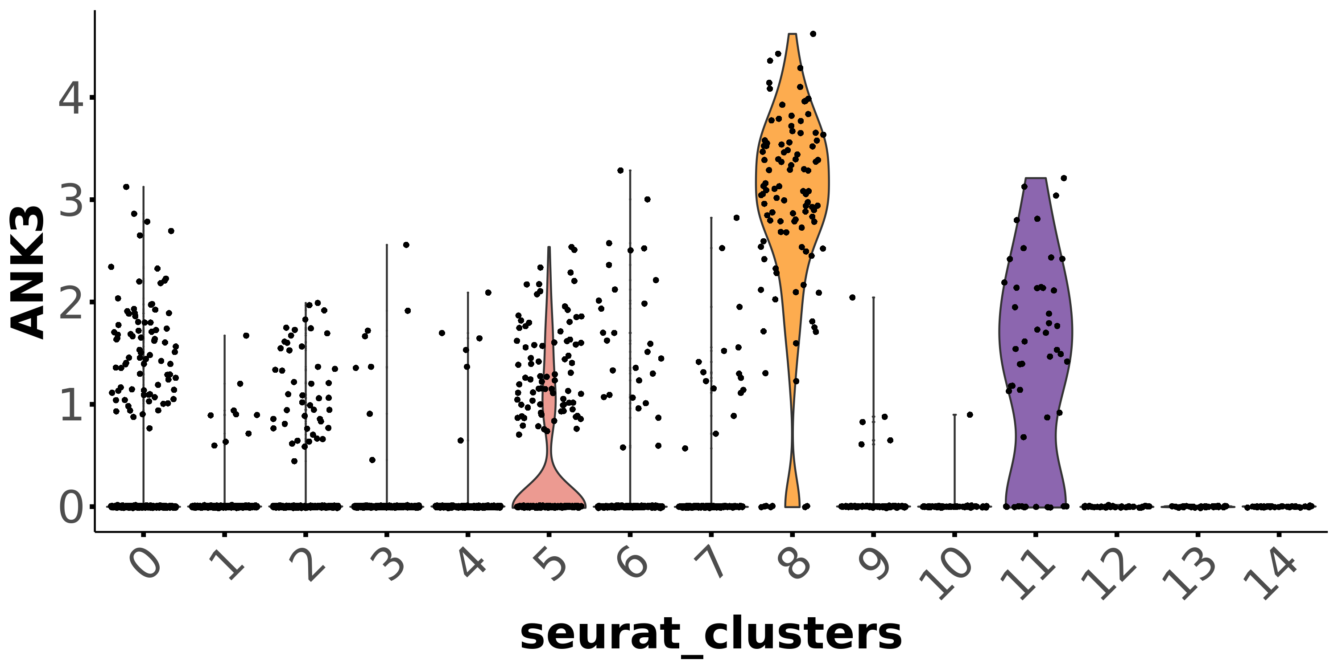
Melanocytes
Neuronal cells
Cluster #12
Cluster #8

Slide 8
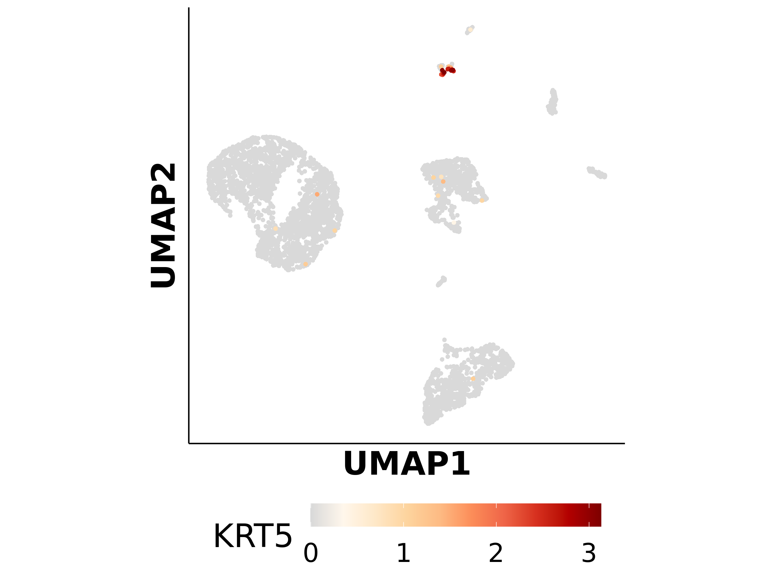
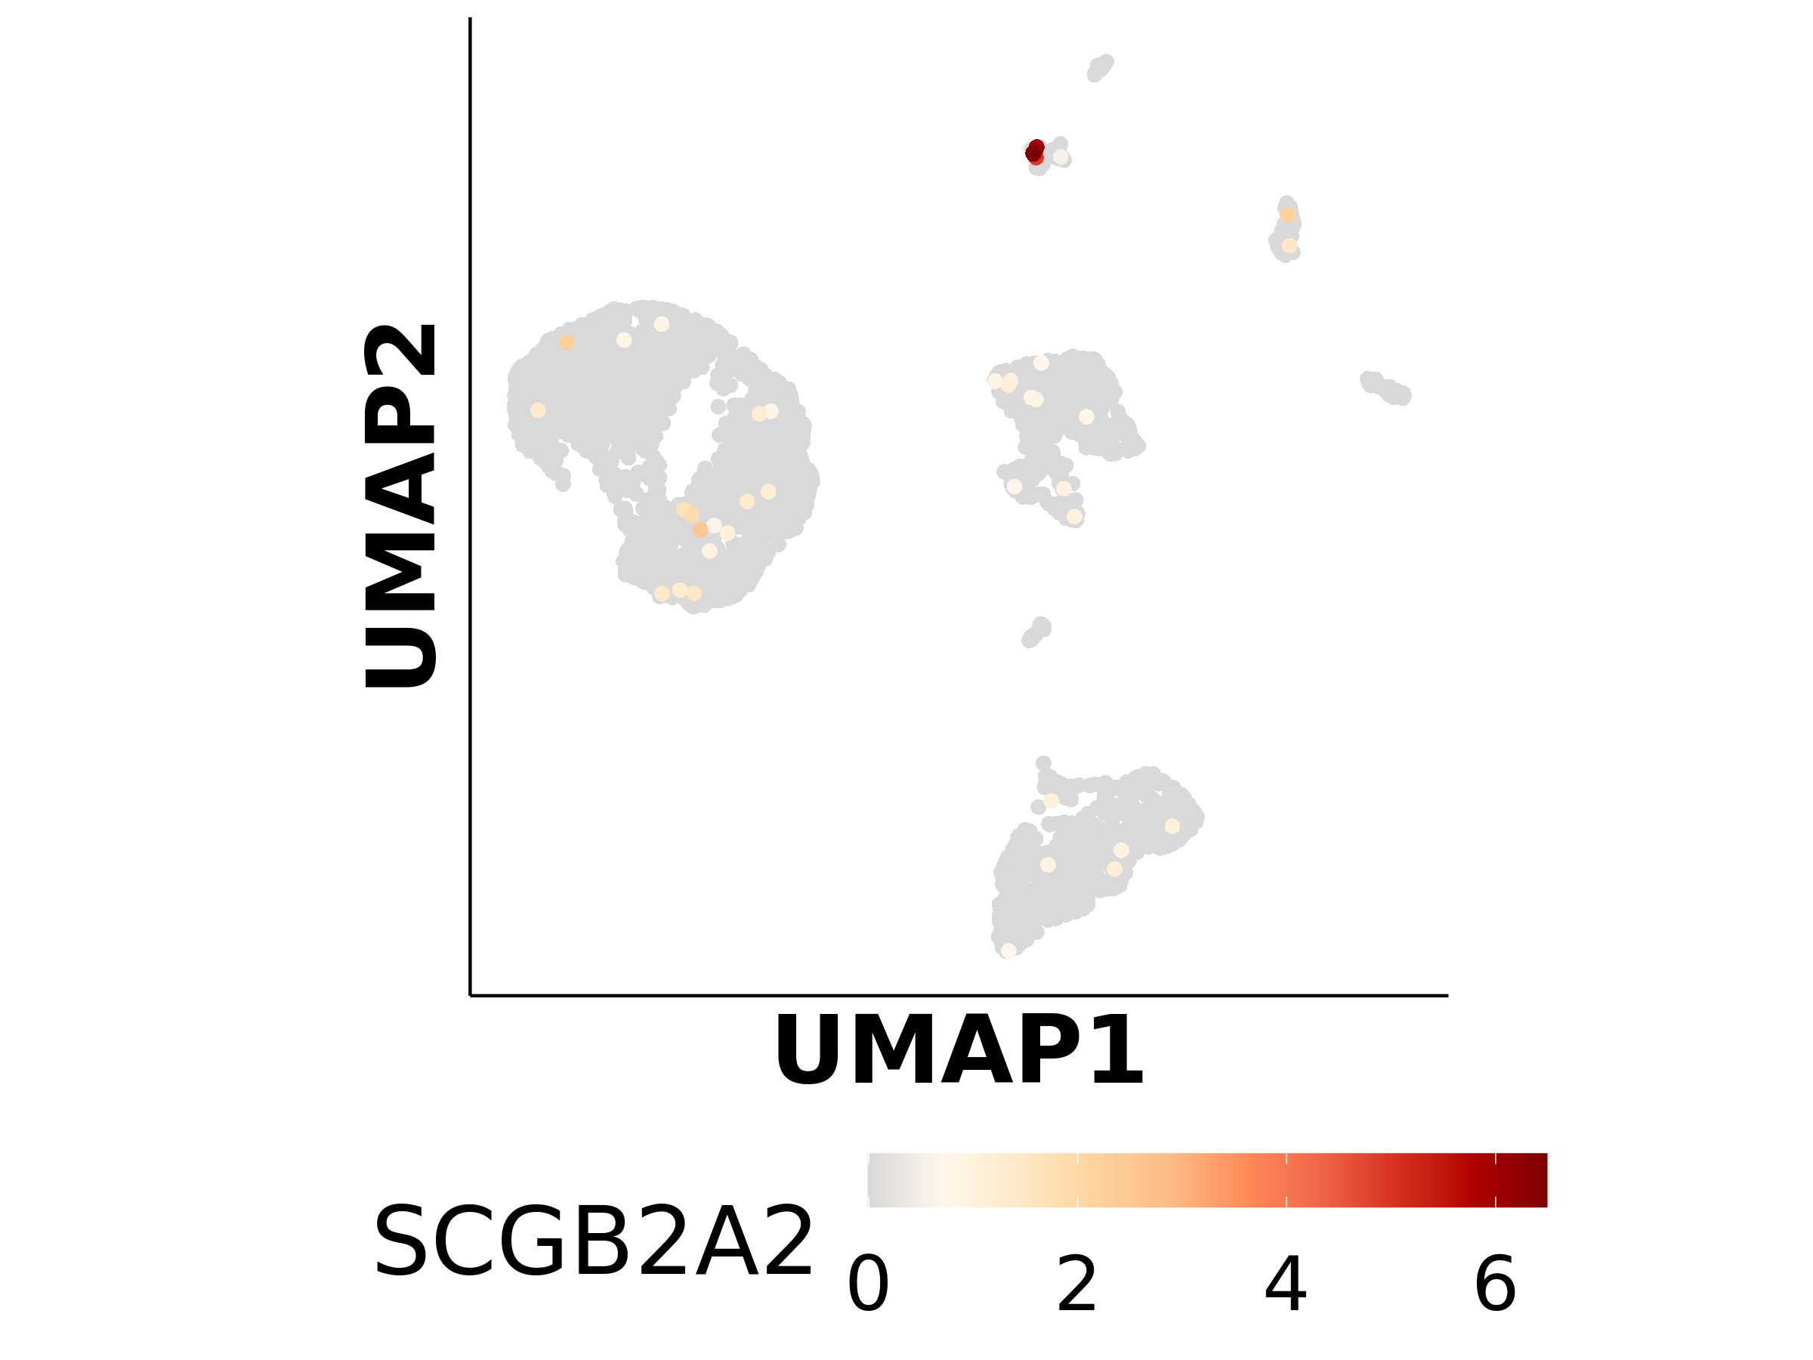
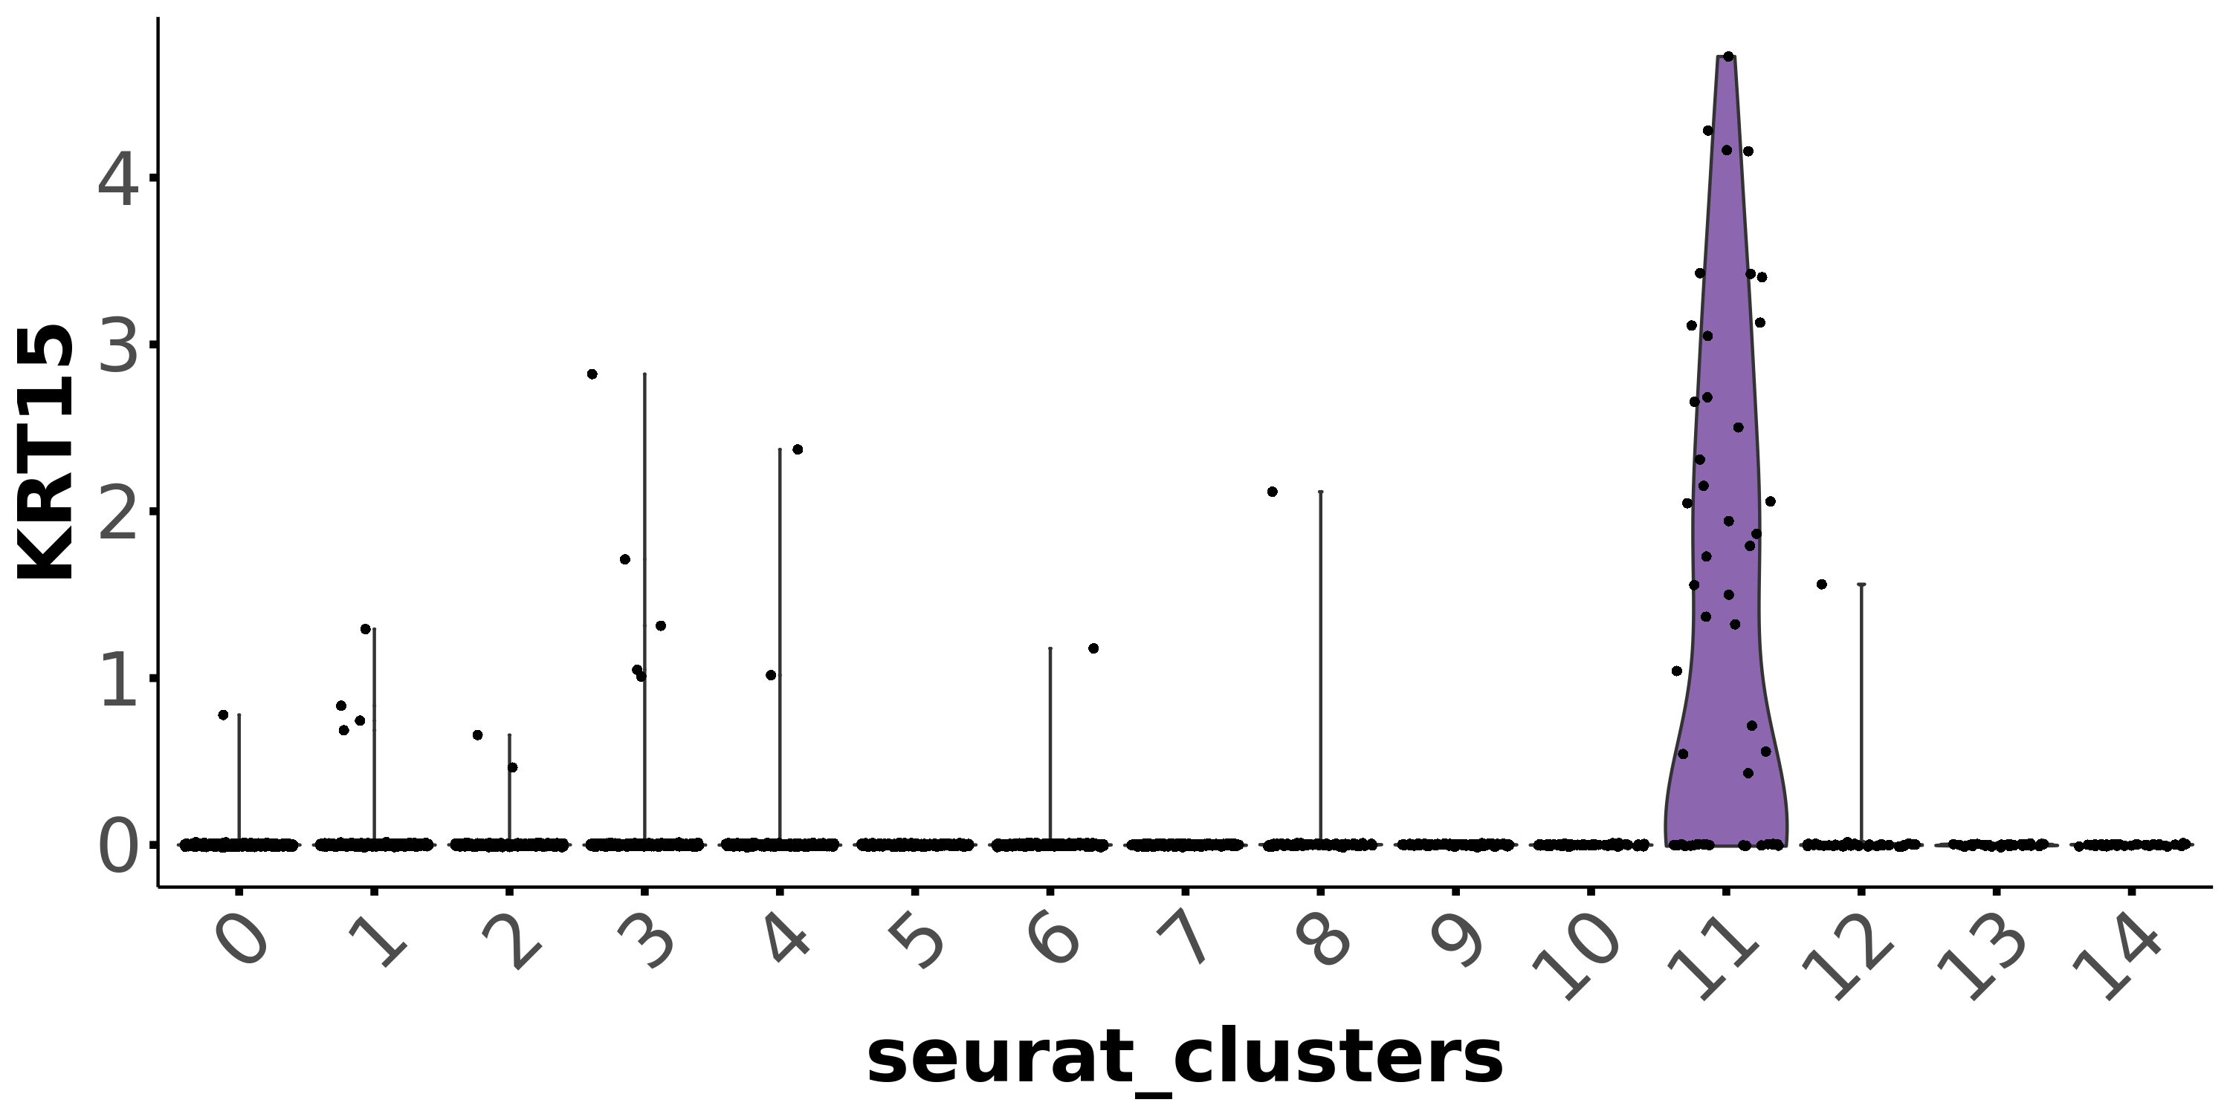
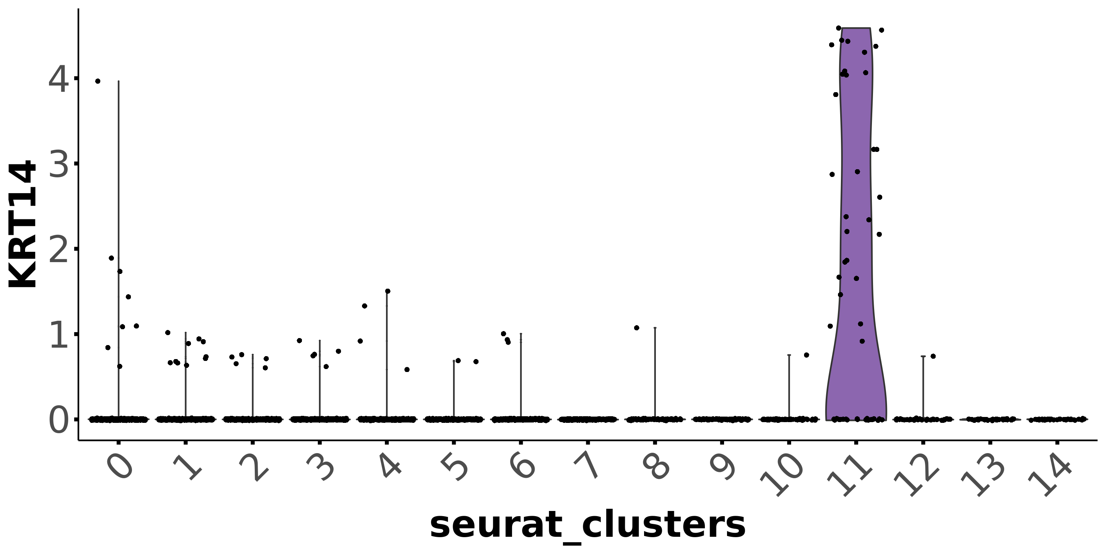
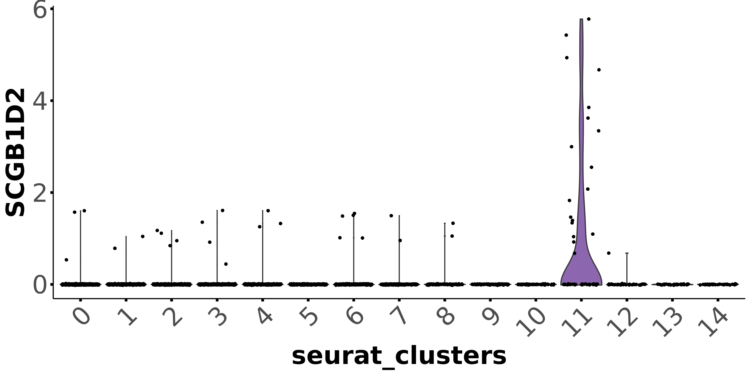
Basal keratinocytes
Sweat-gland-cells
Cluster #11
Cluster #11
Only few Keratinocytes were analysed
Suprabasal keratinocytes are completely missing ->
possibility of missing intraepithelial CD8+ TRM

Slide 9
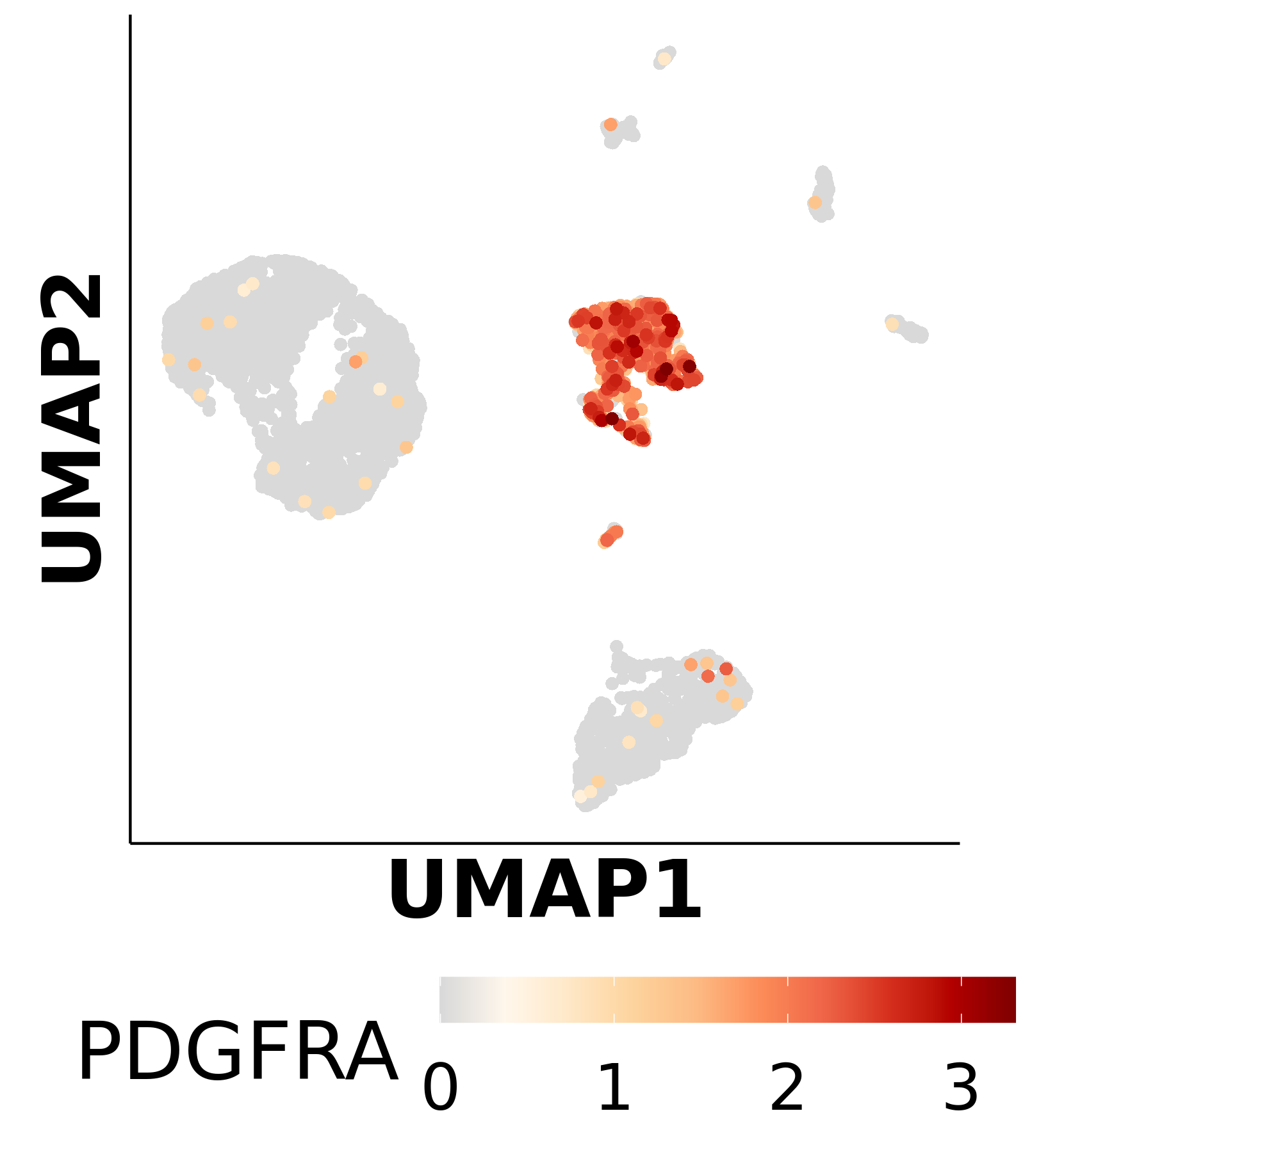
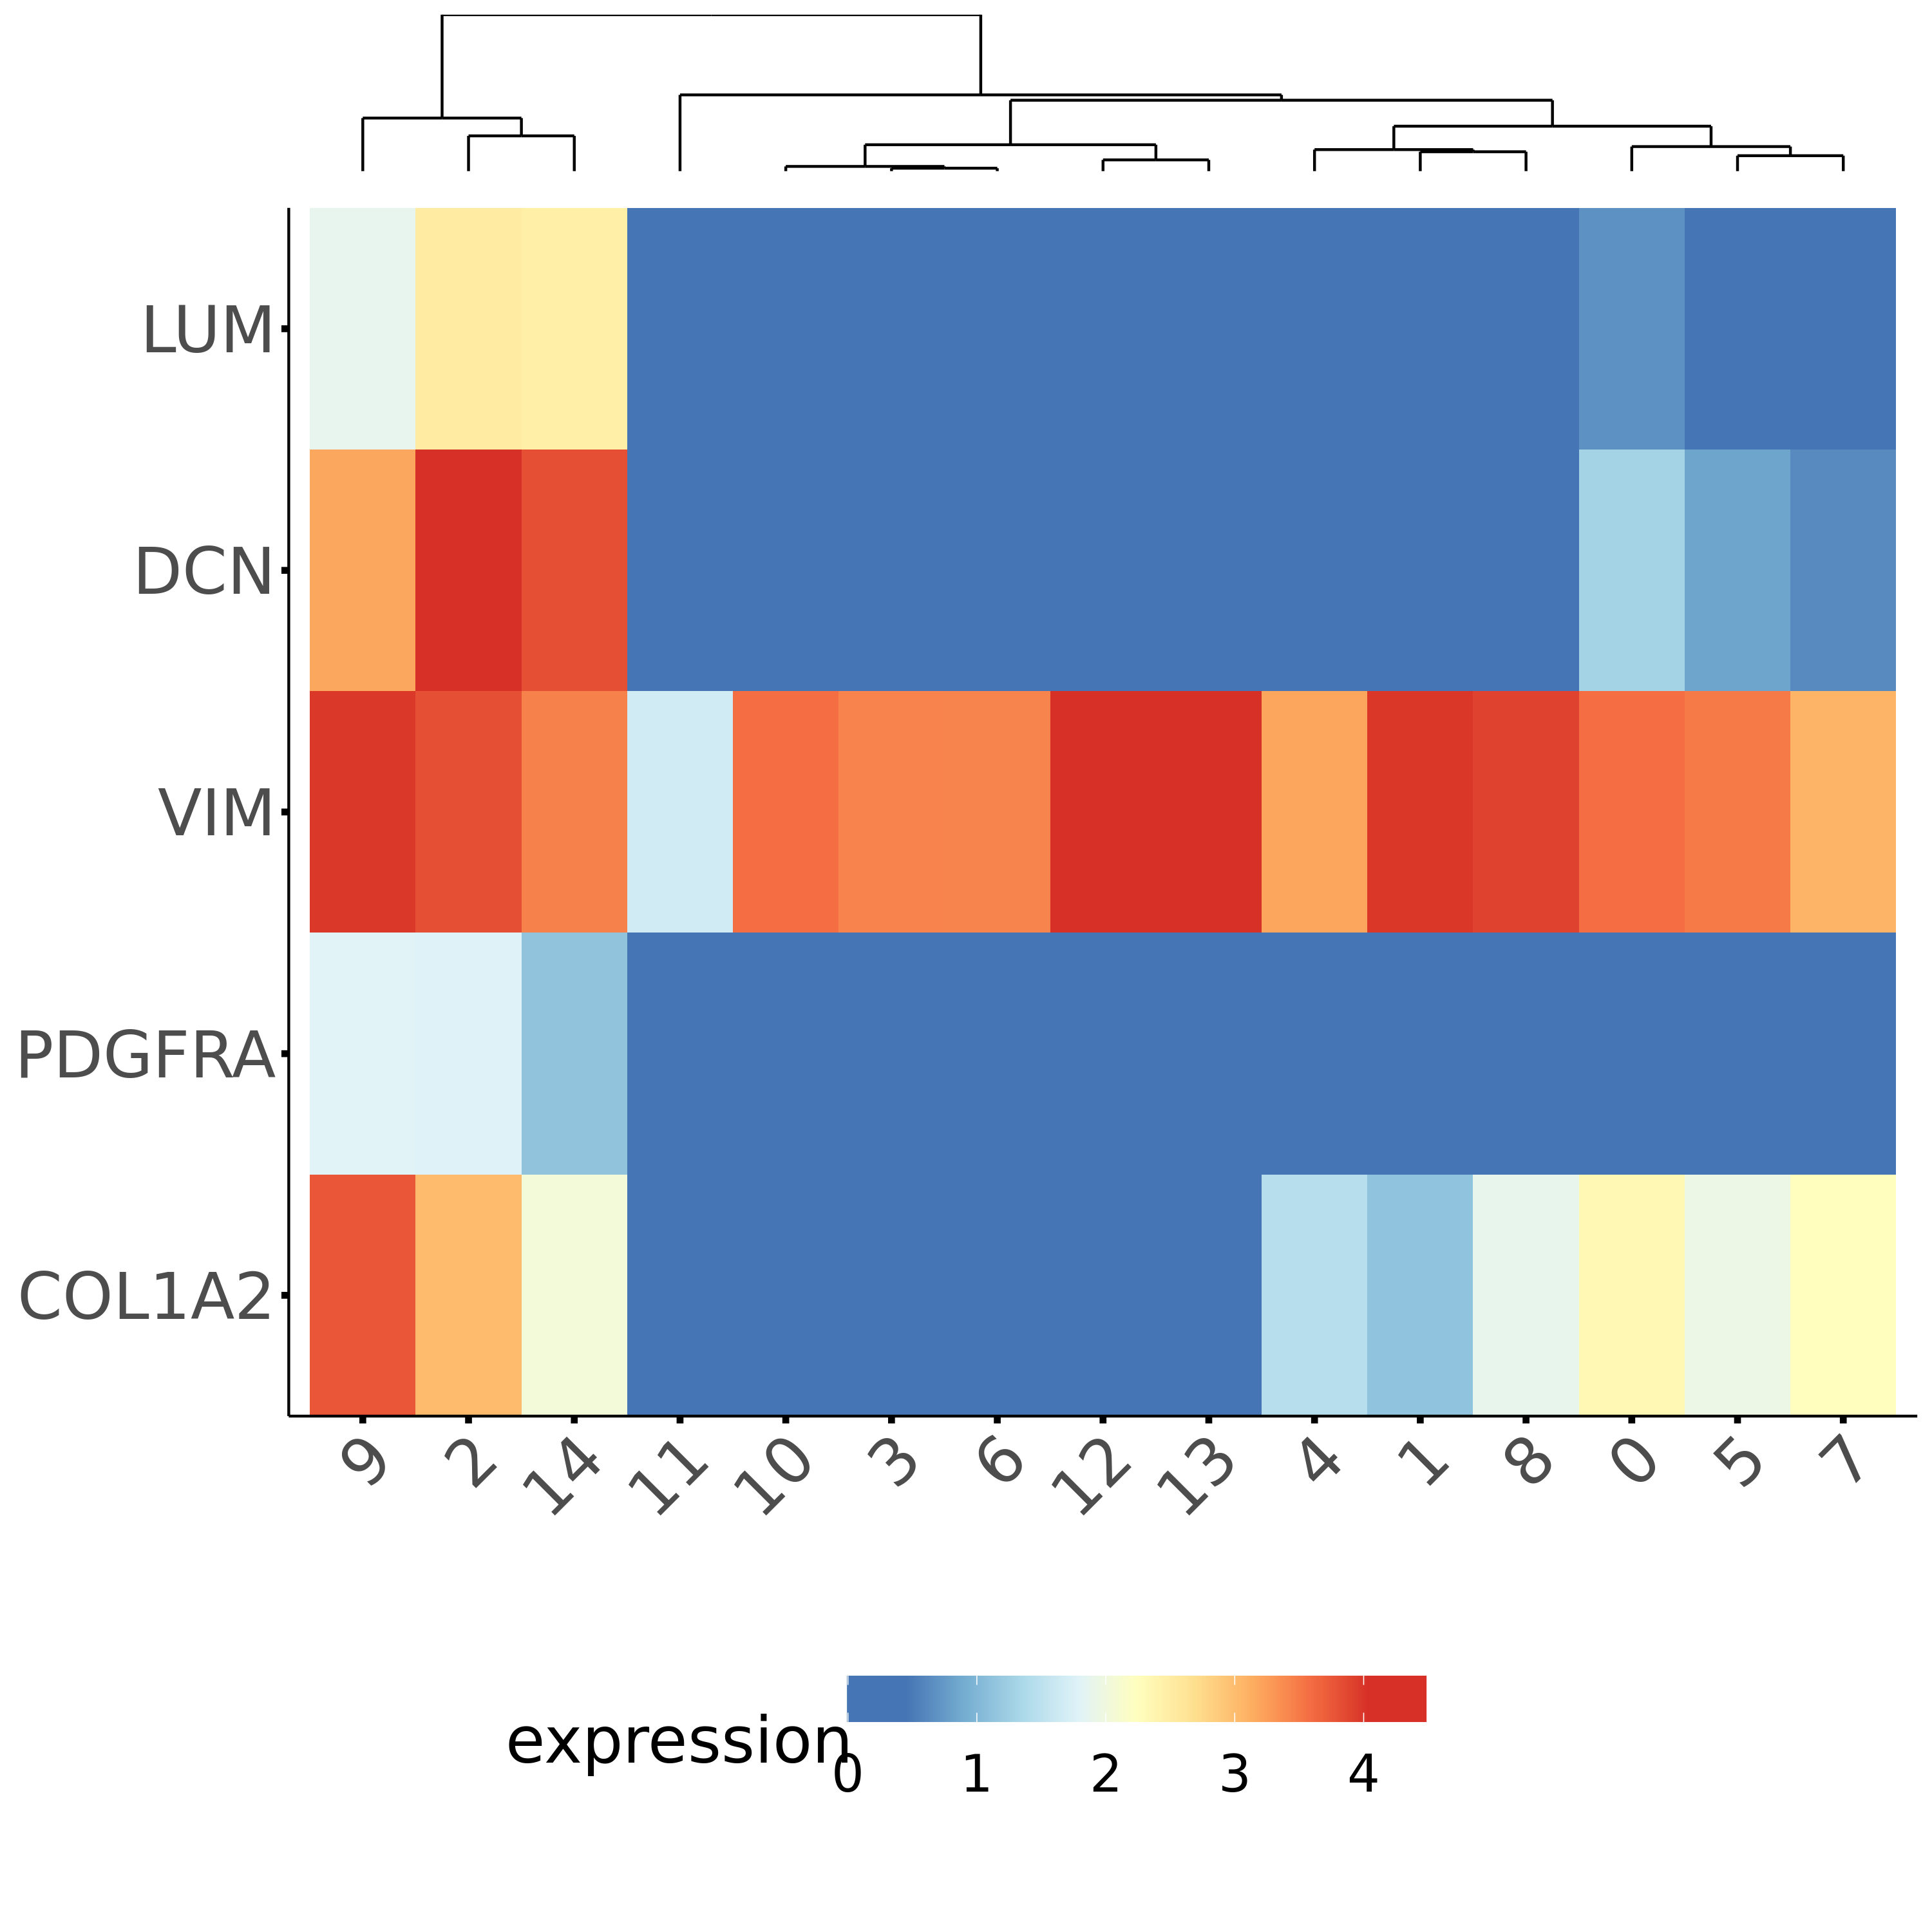
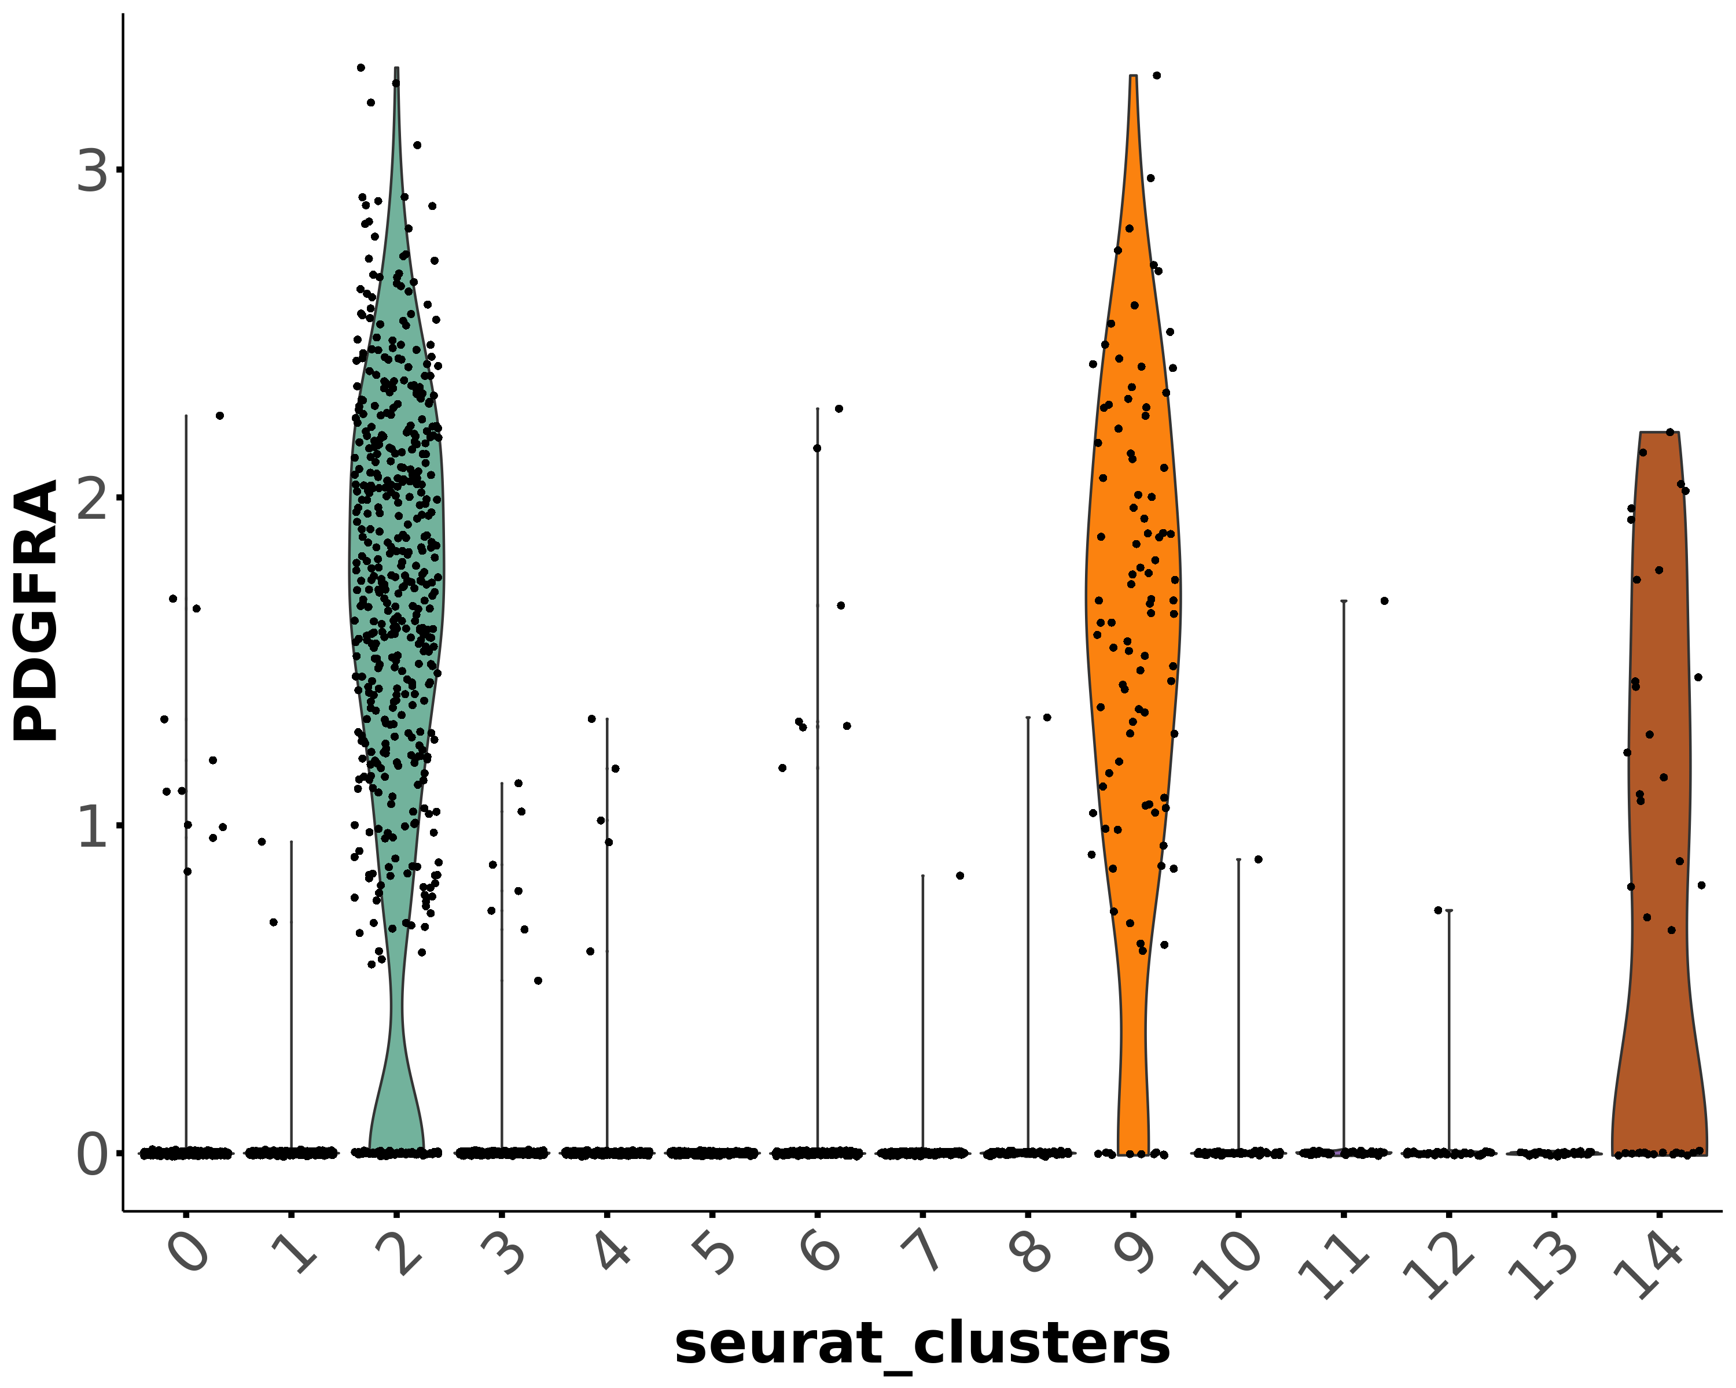
Fibroblasts
Fibroblasts

Slide 10
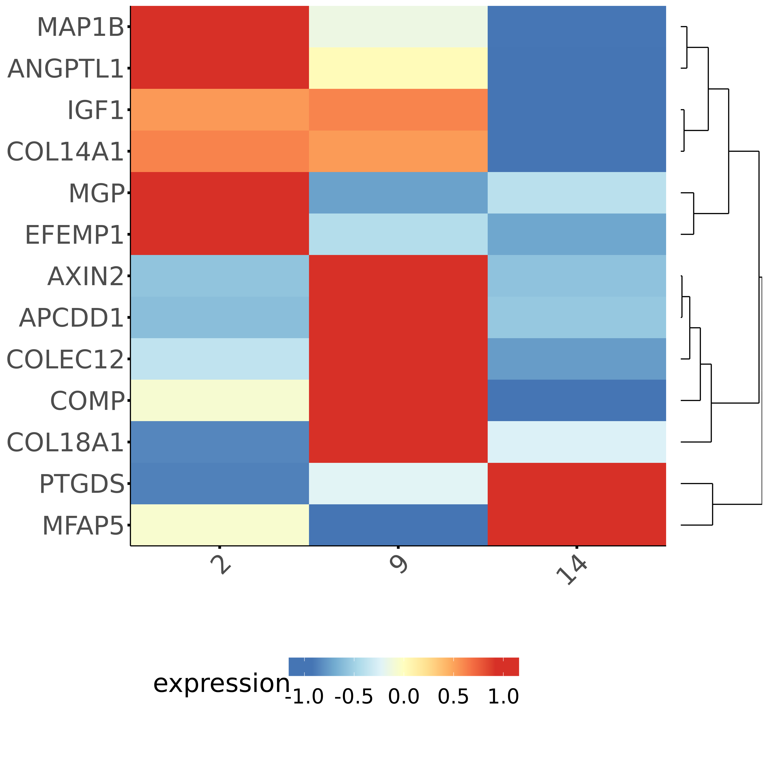
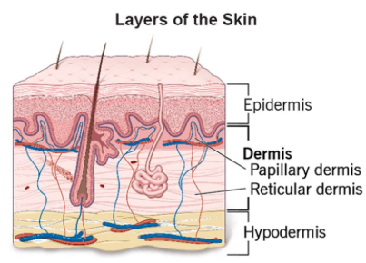
Fibroblasts subtypes
Reticular
Papillary

Slide 11
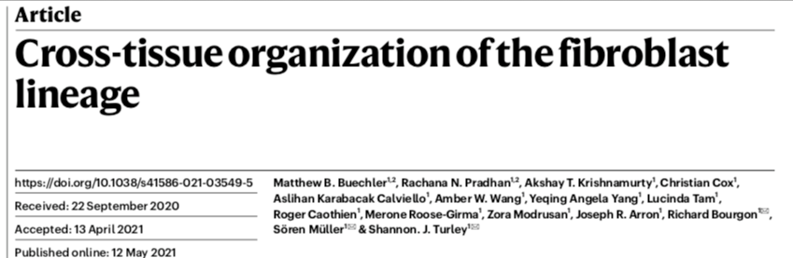
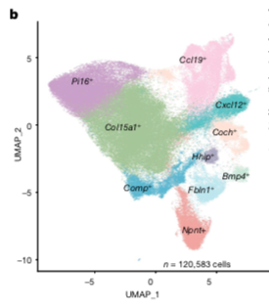
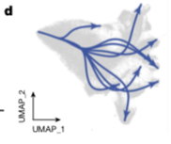
Pi16+ DPT+ = universal / adventitial stromal cells
Reside in vascular niches and may acquire gene expression profile of specialized fibroblasts
Specialized fibroblasts emerge from Pi16+ DPT+ cells and pass through Col15a1+ DPT+ stromal cells (basement membrane association)
Both populations are so called “universal” and can give rise to distinct, tissue specific fibroblasts in steady state and disease.

Slide 12
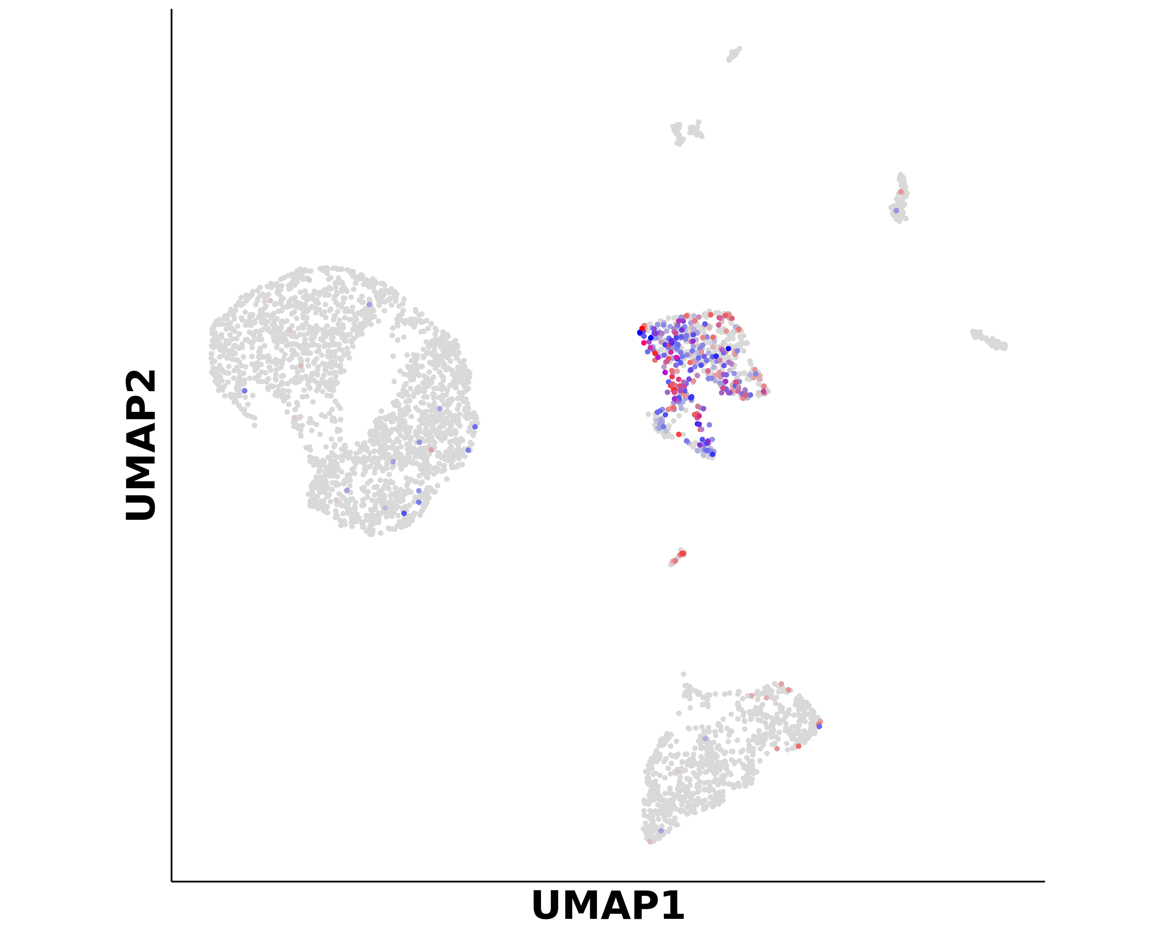
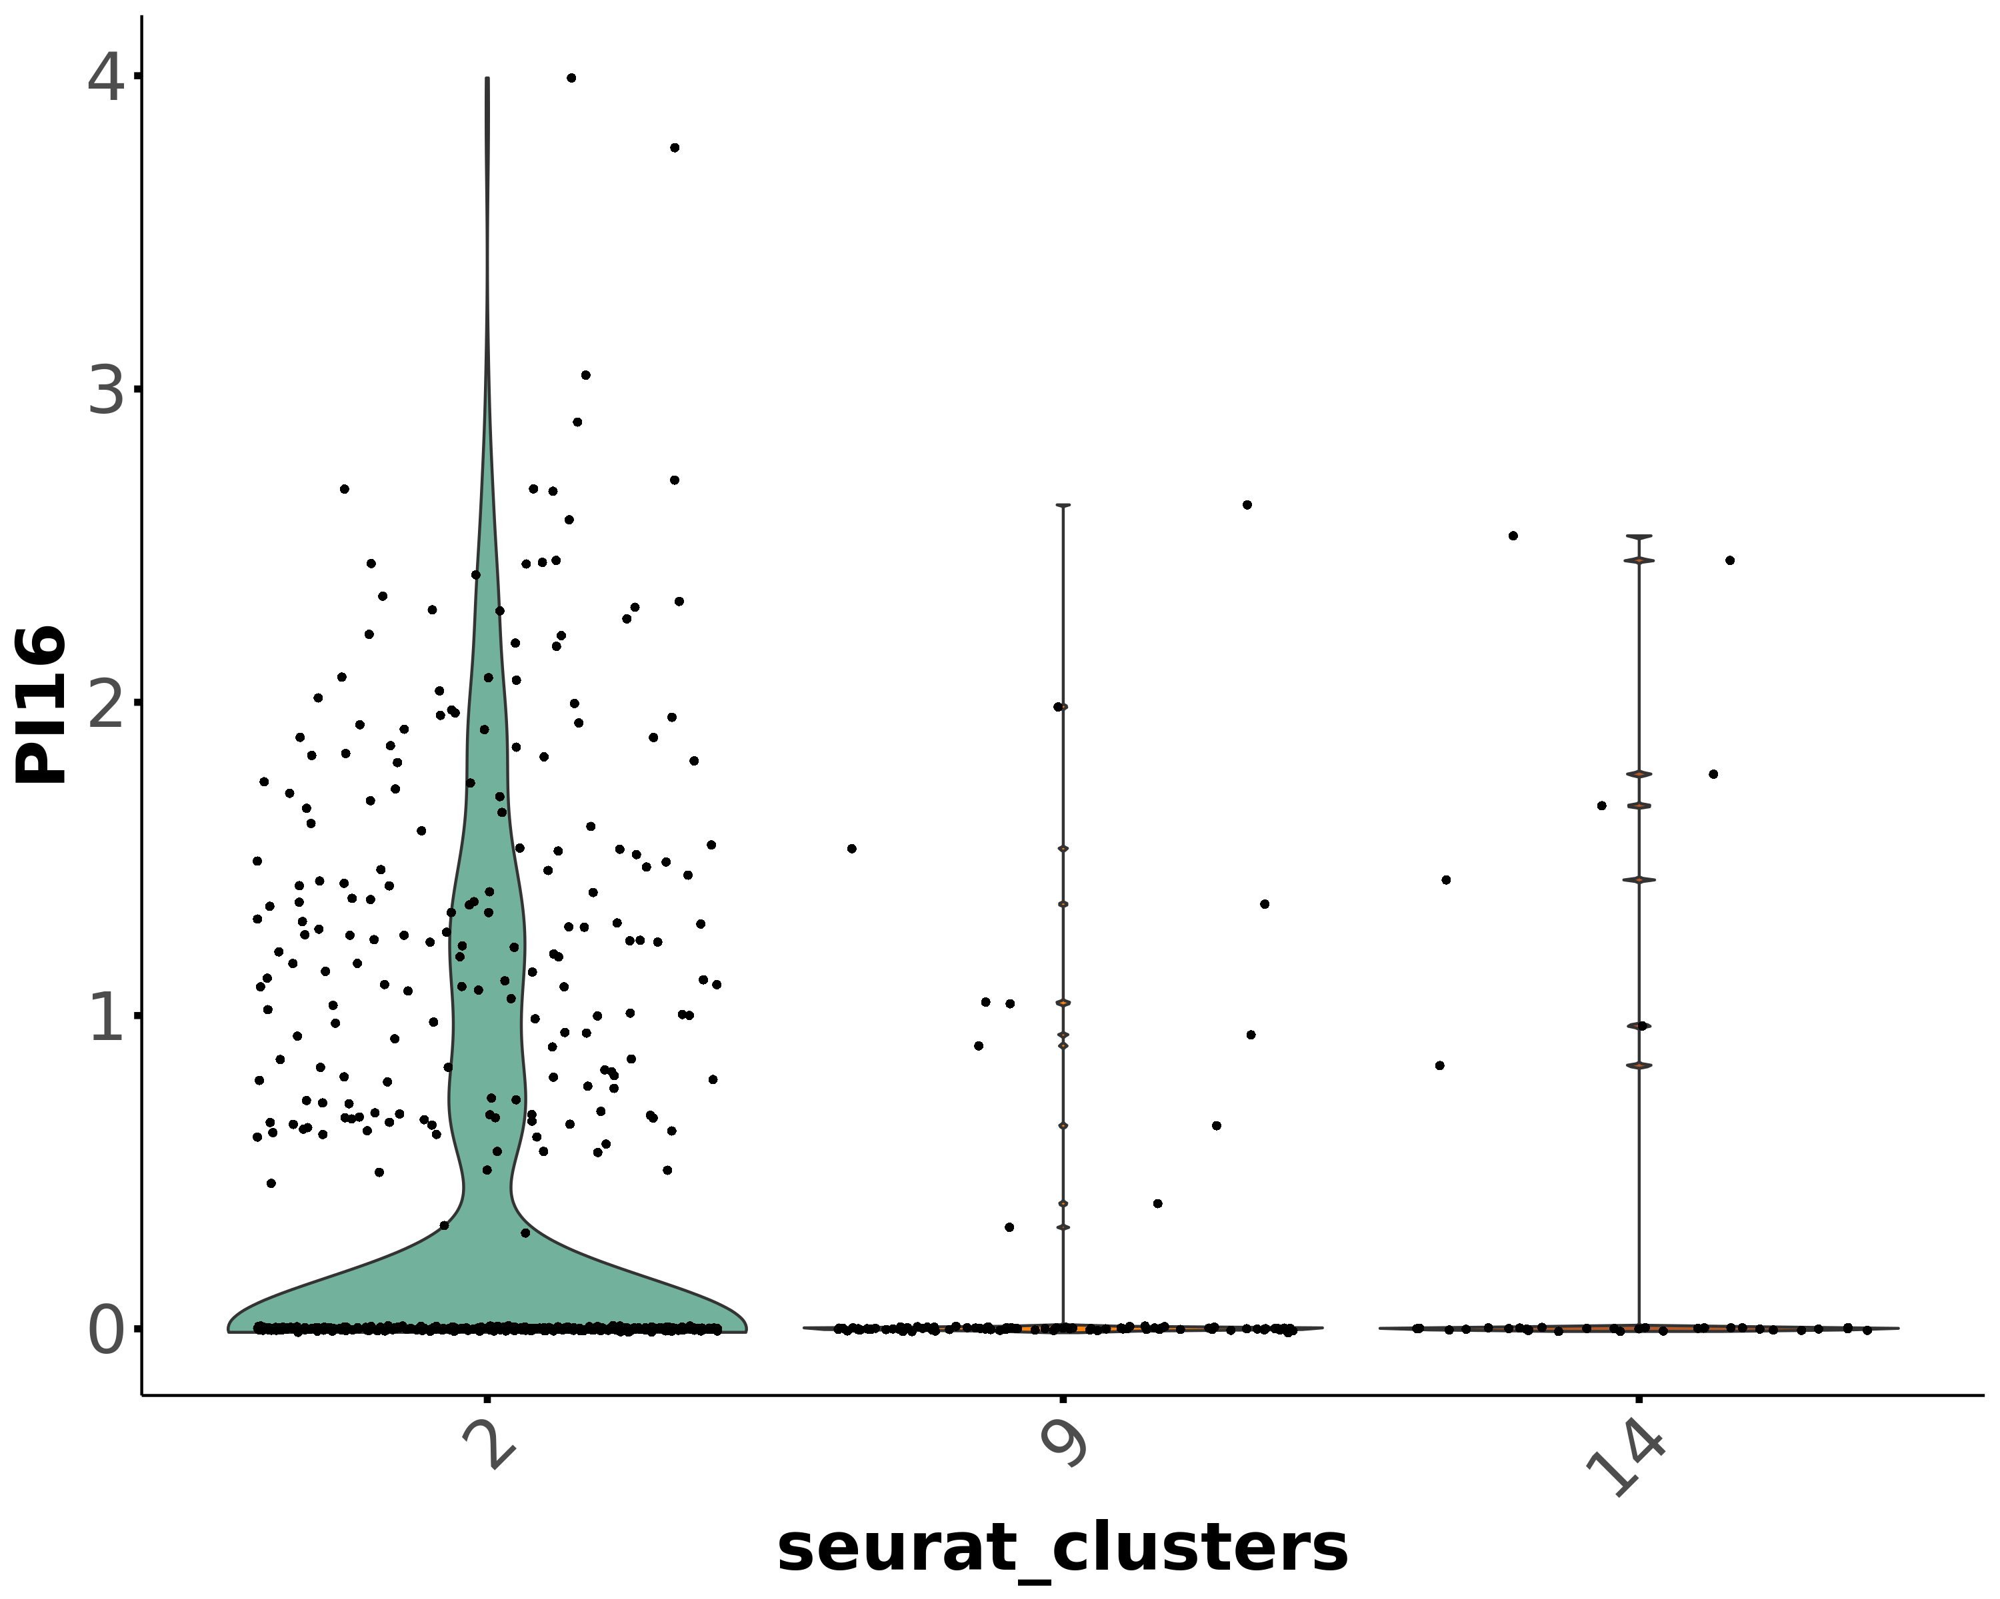
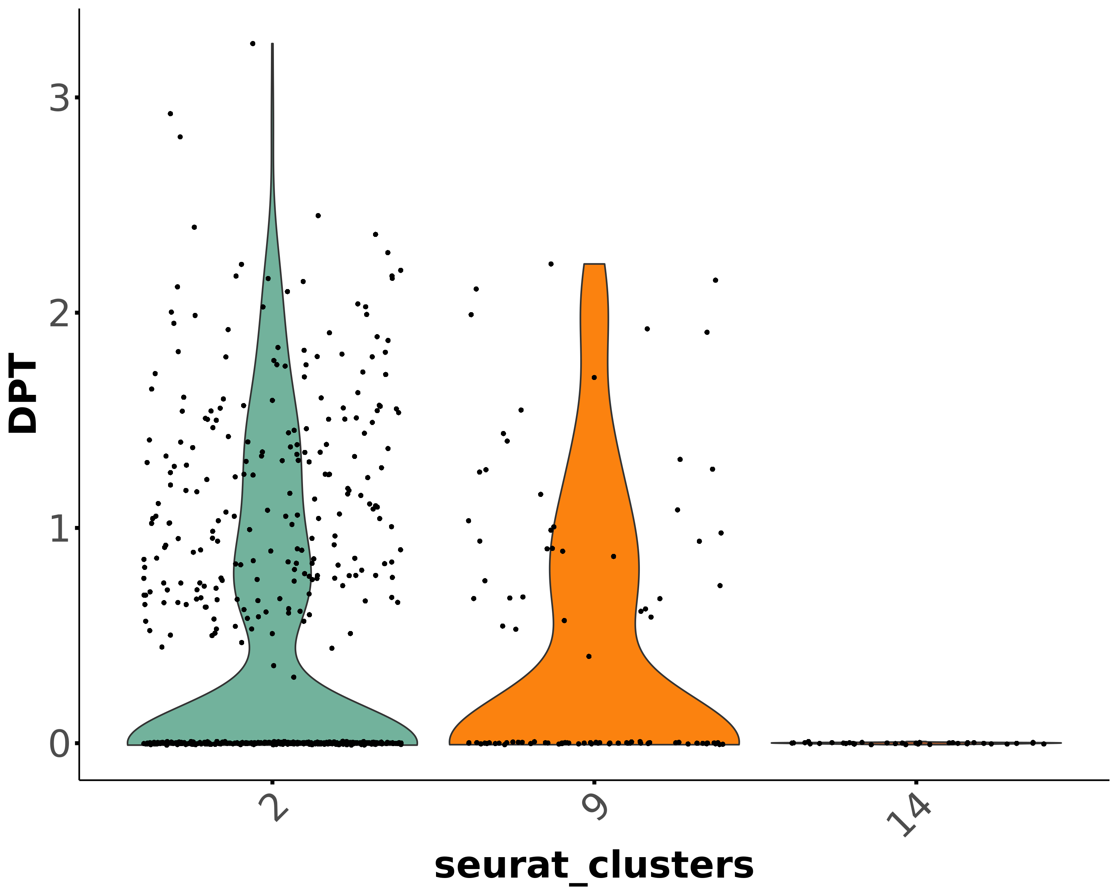
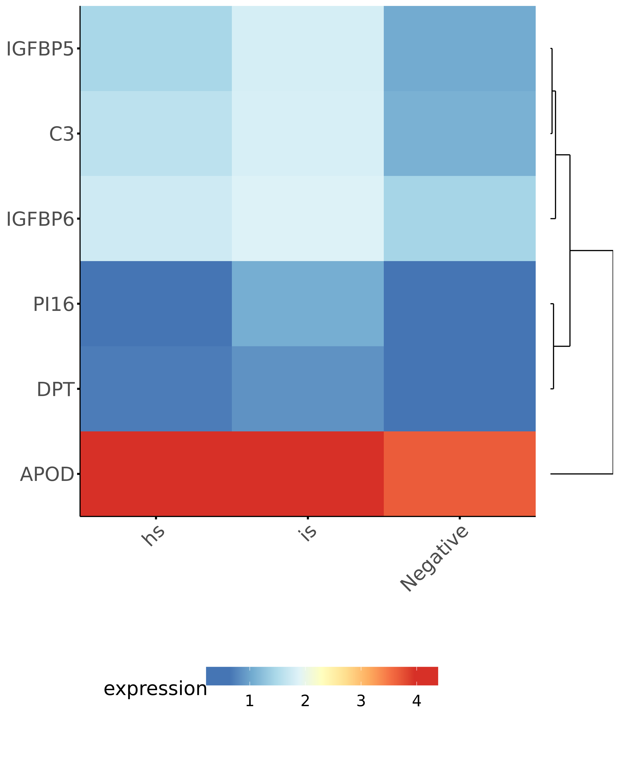
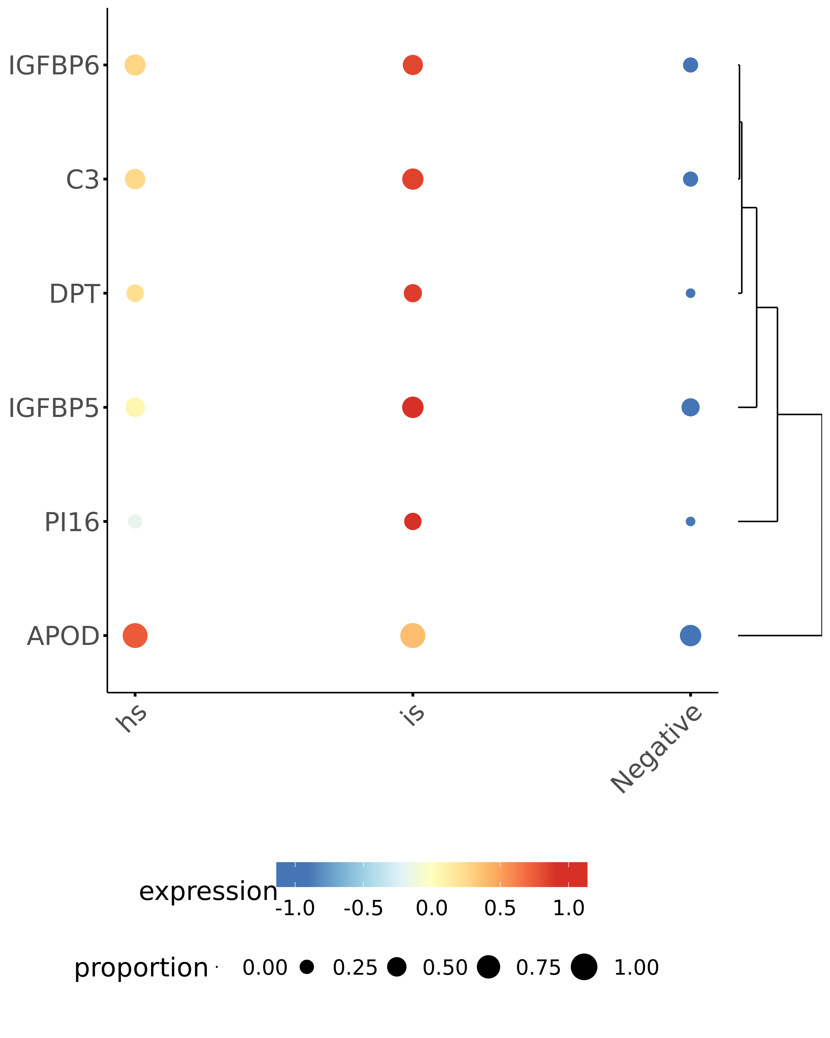
Universal stromal cells in human skin
Cl. 2/9/14 nCells percent
both 112 16.62
PI16 96 14.24
DPT 160 23.74
none 306 45.40

Slide 13
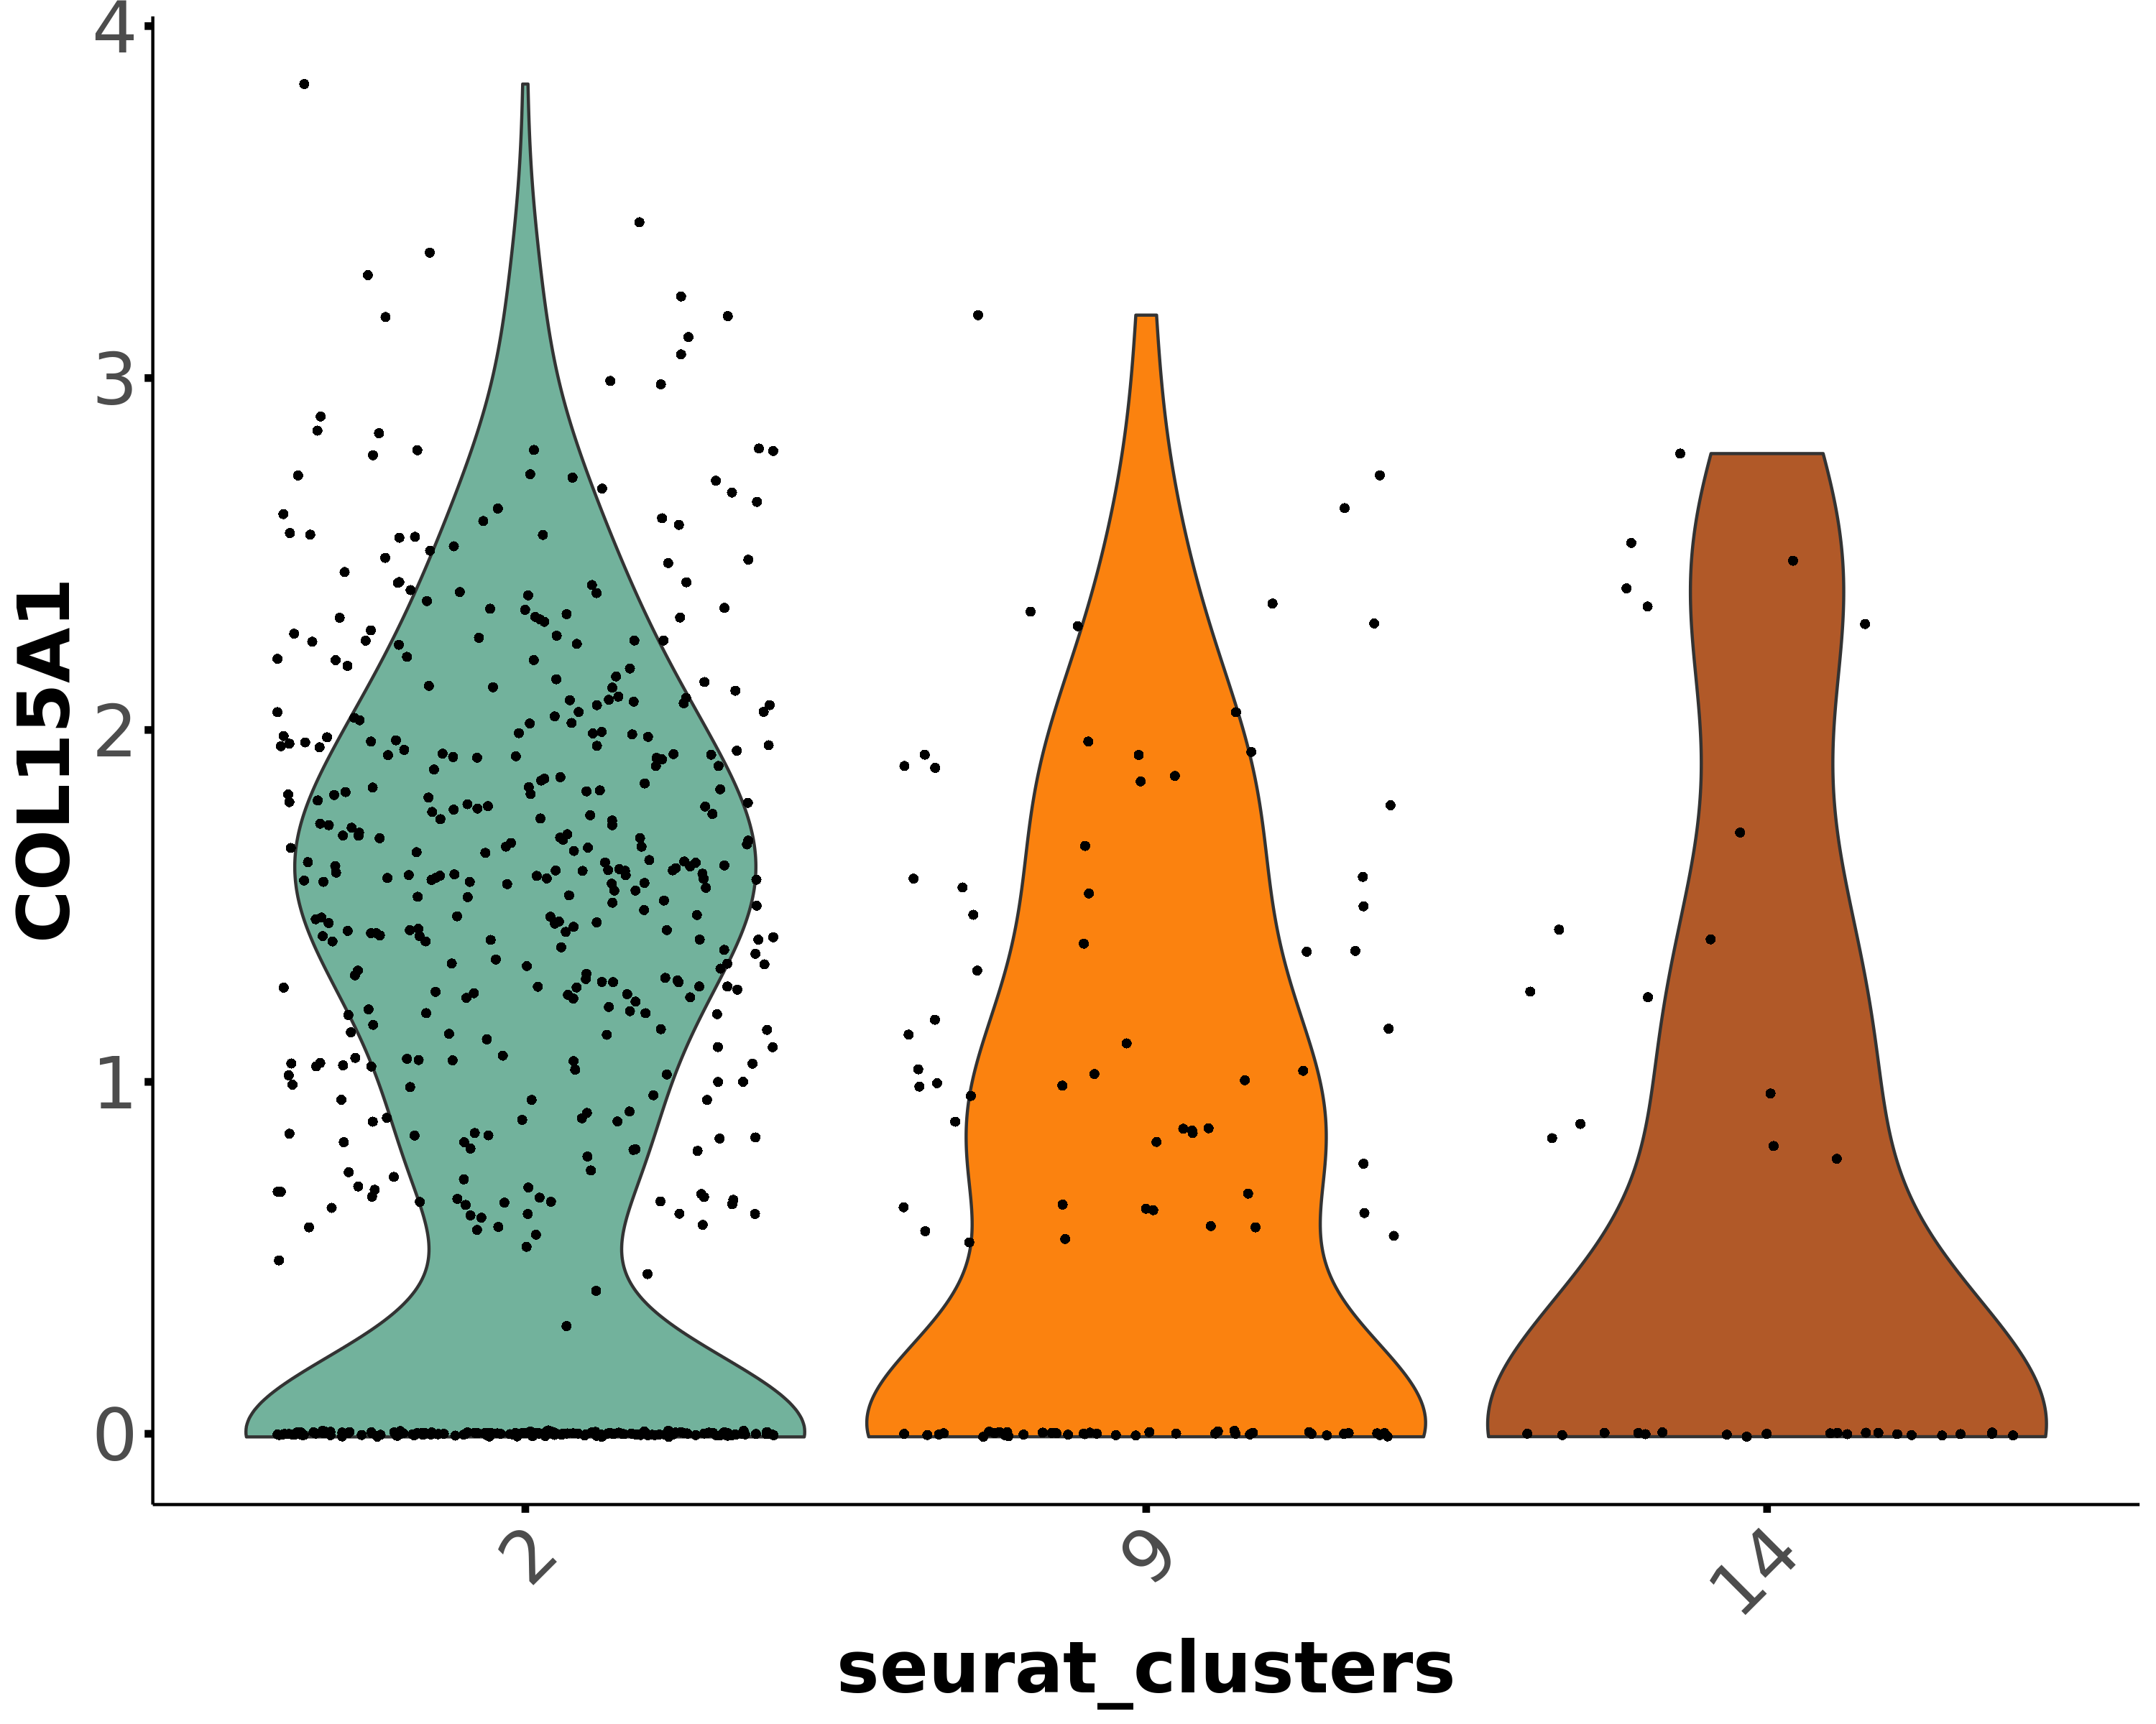
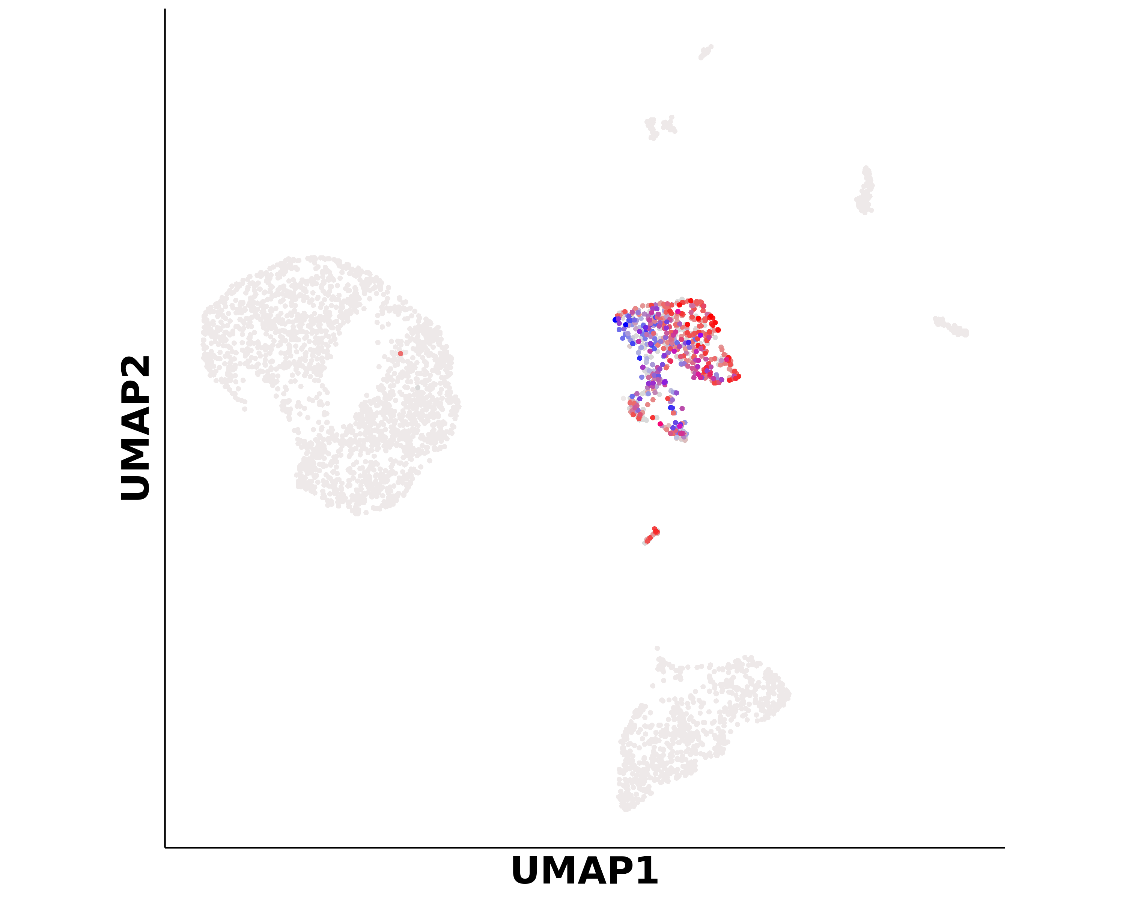
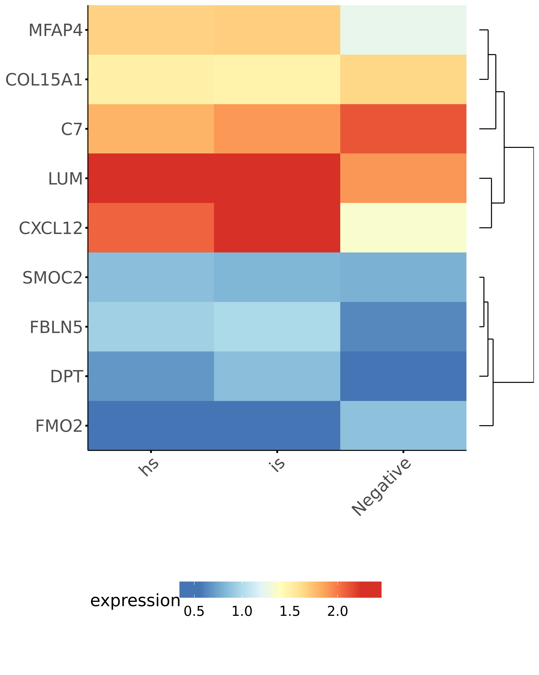
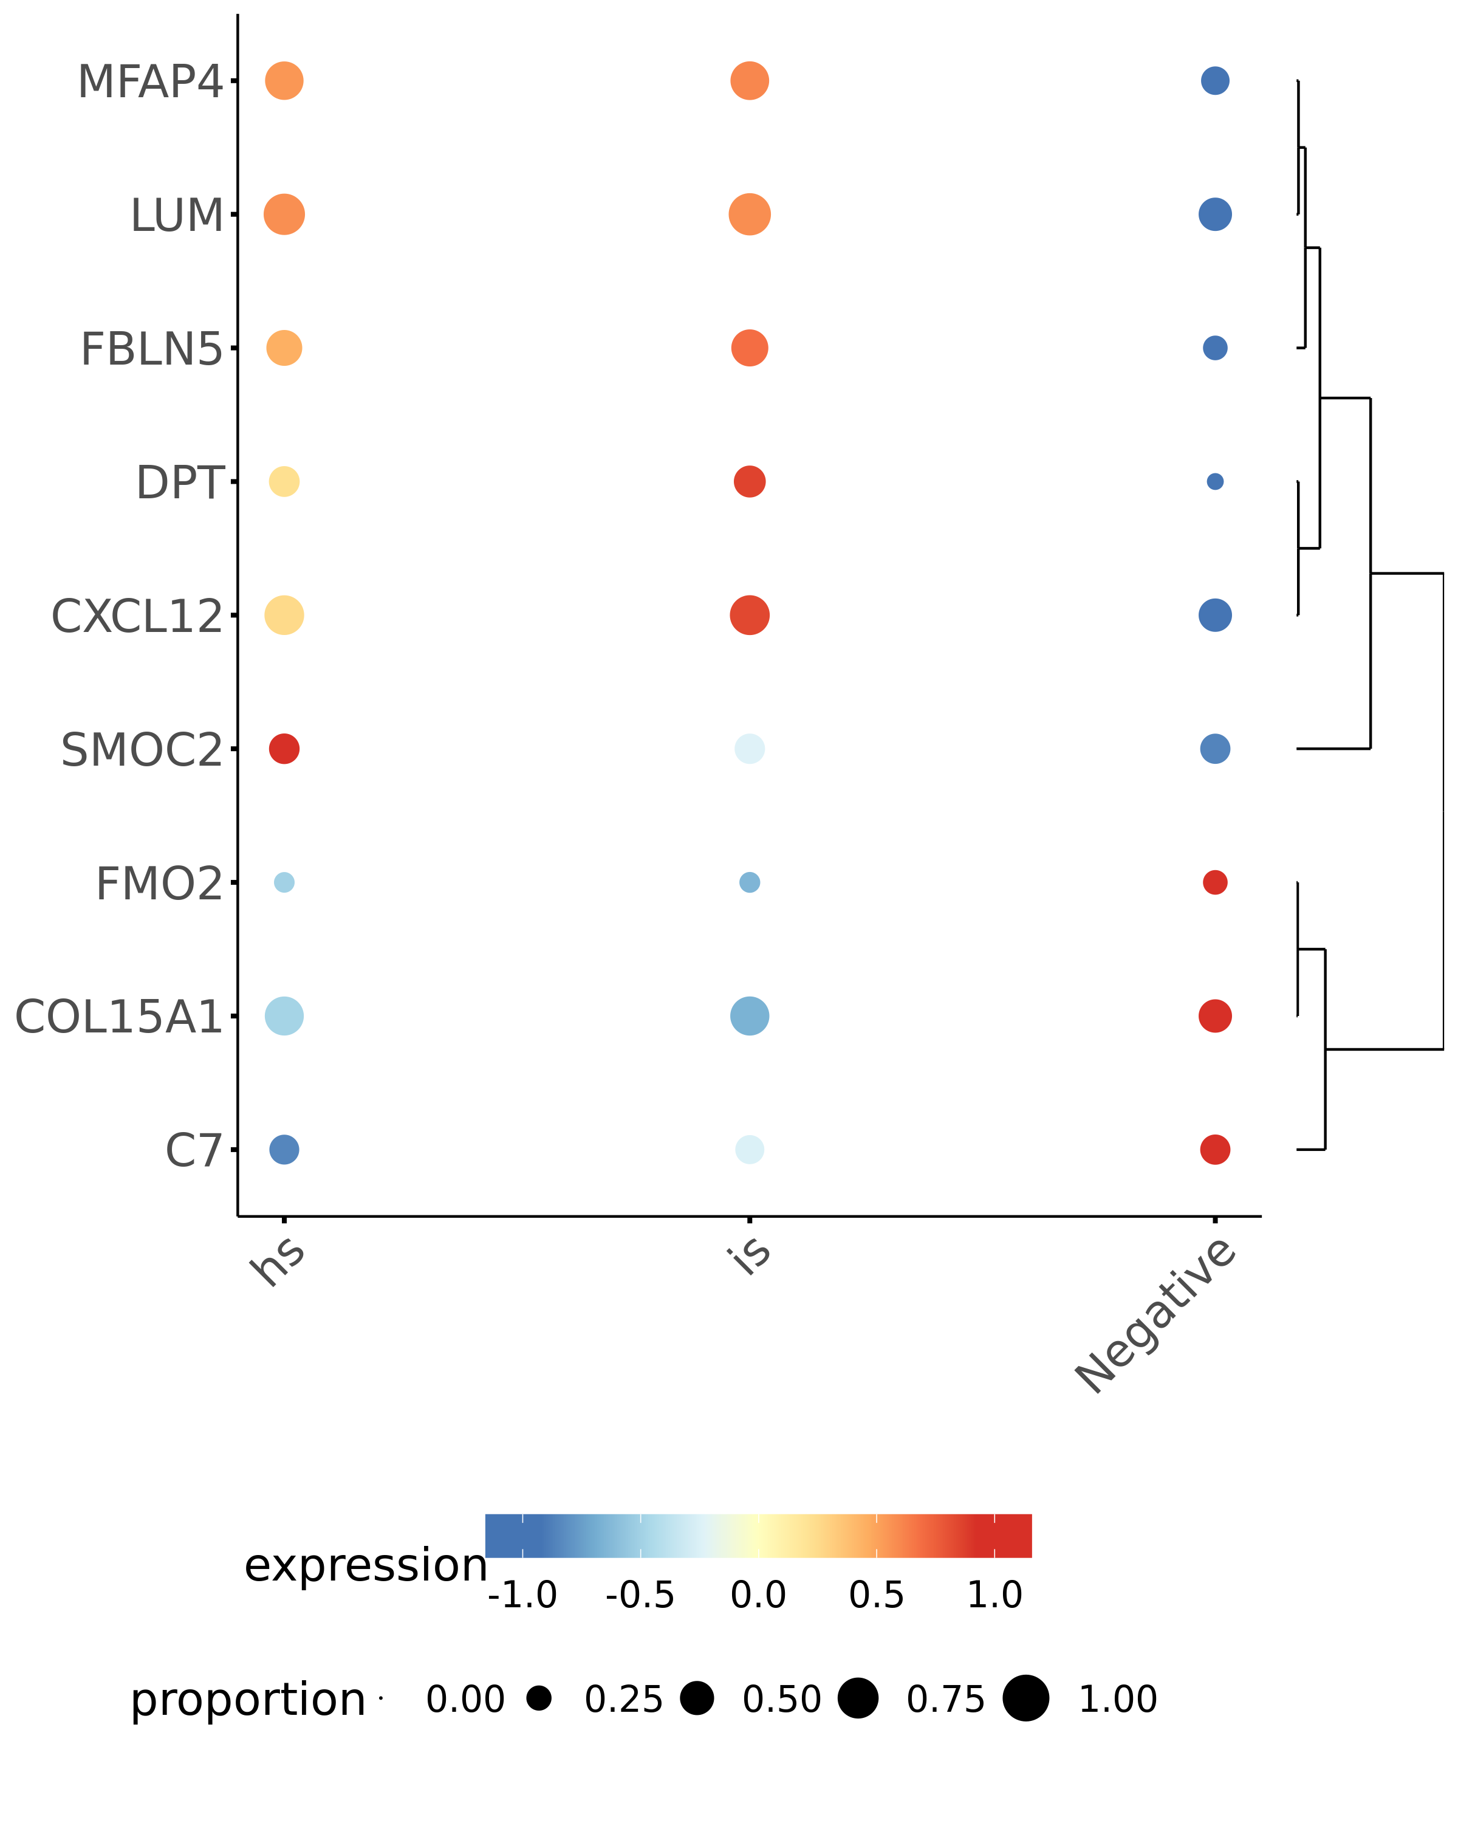
Universal stromal cells in human skin
Cl. 2/9/14 nCells percent
both 195 28.93
COL15A1 256 37.98
DPT 77 11.42
none 146 21.66

Slide 14
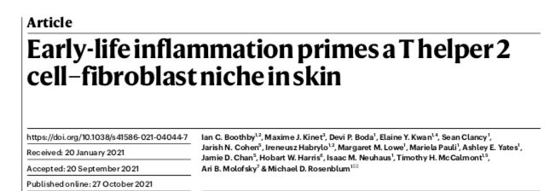
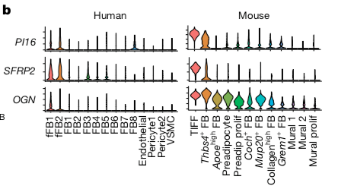
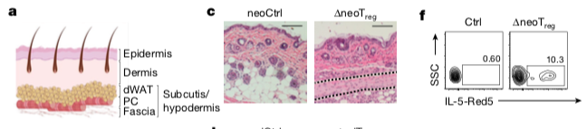
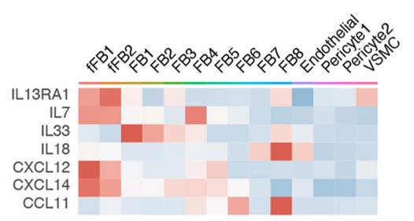
Neonatal TREG depletion causes TH2 mediated fascial fibrosis through polarisation and activation of TIFFs (TH2 interacting fascial fibroblasts).

Slide 15
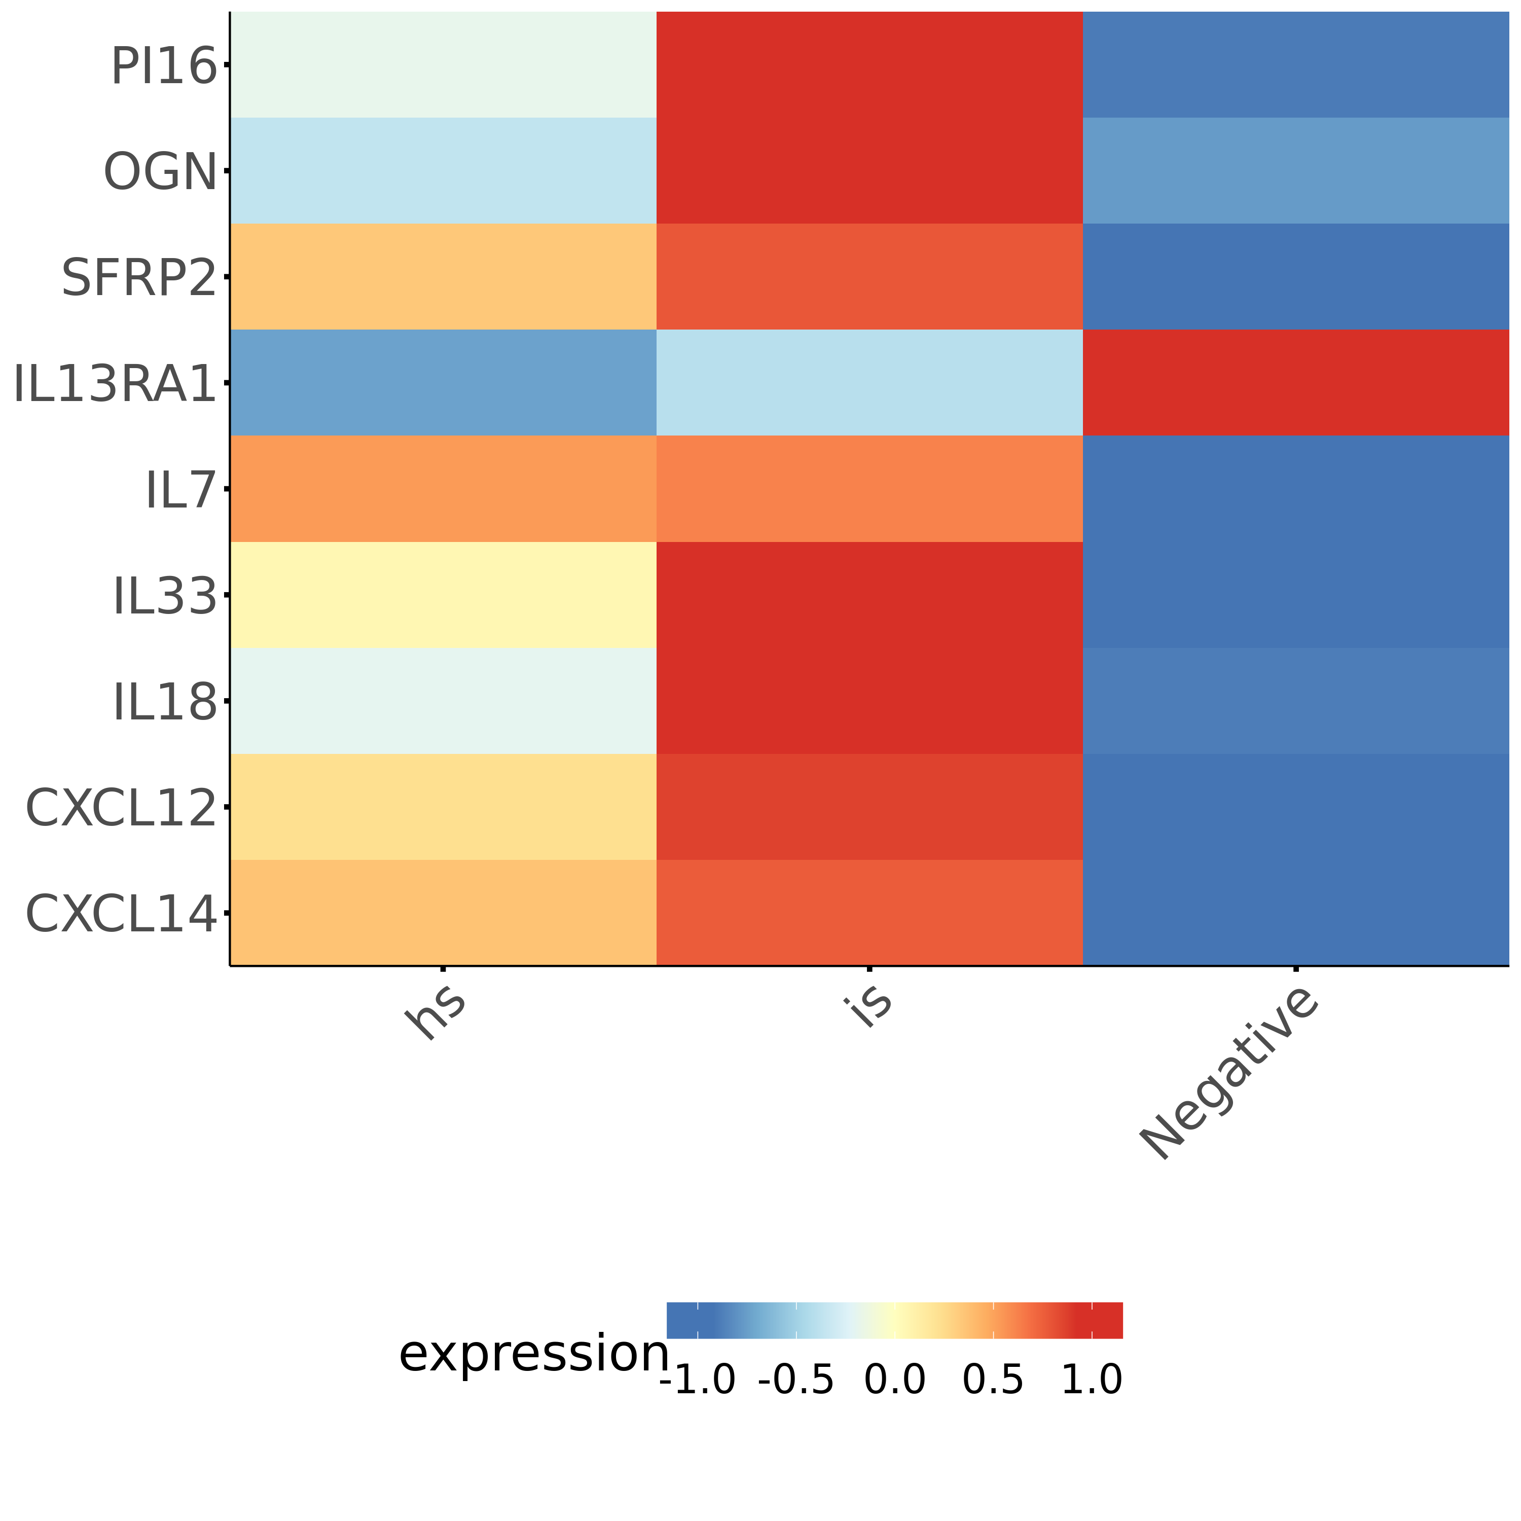
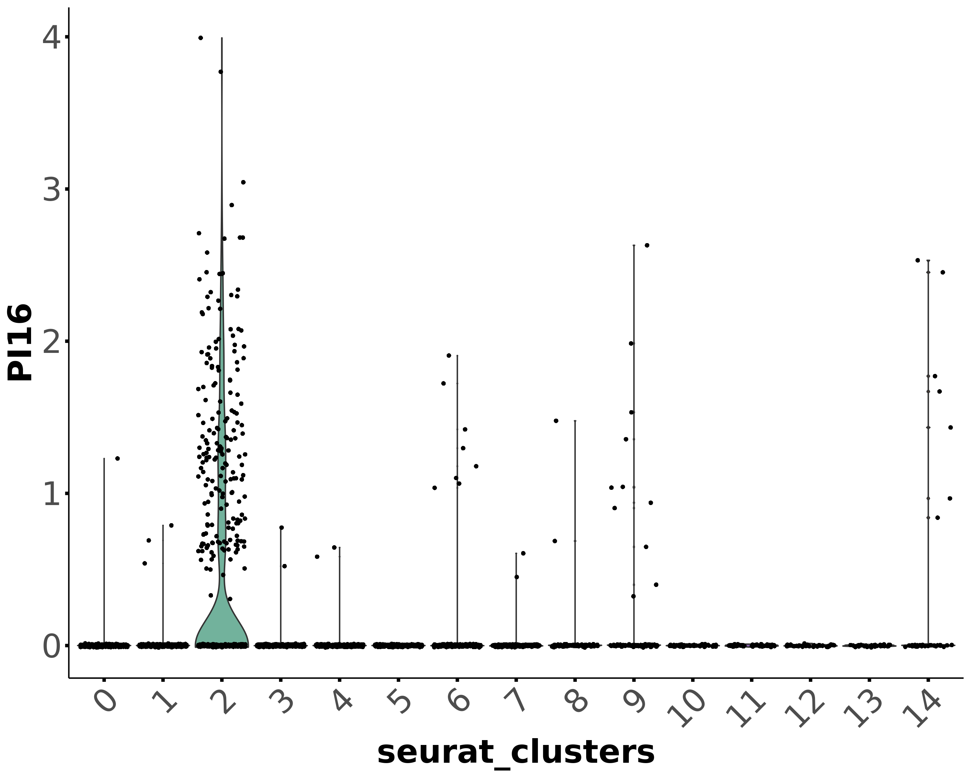




Human TIFF-like fibroblasts?
Cluster #2 Fibroblasts

Slide 16
Cell populations (Leukocytes)

Slide 17


Human skin: Single cell sequencing Data – Leukocytes
CD45

Slide 18



Slide 19






Type I
Type I
Type II
Type III

Slide 20


Human skin: Leukocyte cell cluster identity
Stromal cells
NK cells C#3
CD8 T-cells C#0/6
CD4/8 Tcells C#11/1/4/16
CD4 T-cells C#2
pDCs C#14
cDC1 C#13
cDC2 C#12
Macrophages C#13

Slide 21


Type I dominated immune response, ILC1 existence?
Gene nCells percent
both 1187 31.52
IL7R 284 7.54
TRAC 423 11.23
none 1872 49.71
Gene nCells percent
both 230 6.11
IL7R 1241 32.95
EOMES 337 8.95
none 1958 51.99

Slide 22



C#0/6 diff. cytotoxic Hobit(hi) Cd127(-)
Gene nCells percent
both 240 20.46
ZNF683 26 2.22
TRAC 609 51.92
none 298 25.40
Gene nCells percent
both 63 5.37
ZNF683 203 17.31
TCF7 348 29.67
none 559 47.66

Slide 23


Post lesional skin:
Existence of cytotoxic effector ILC1?
Cluster# 0/6

Slide 24





Differences in NK-cells?
Tissue-resident –NK?
Cluster# 3
circulating NK

Slide 25



Differences in TRM T cell populations?

Slide 26

Regulation of TRM homeostasis
VEC and LEC produce IL15 and IL7

Slide 27


Low level of Type II response in post infected skin

